Slide 1



rgB Meeting
ɸ electroproduction on the neutron with CLAS12
22 May 2026
M. Ronayette, P. Chatagnon
Mathieu Ronayette
1/19
Mathieu Ronayette
RGB Meeting
22 May 2026

Slide 2
ɸ electroproduction on the neutron with CLAS12
Motivations and events selection
Update on dataset used : spring2020 and spring2019
Update on the acceptance : kaons smearing
Update on the acceptance : new method
5. Update on the simulation : impact of the SDME
Mathieu Ronayette
2/19
Mathieu Ronayette
RGB Meeting
22 May 2026

Slide 3
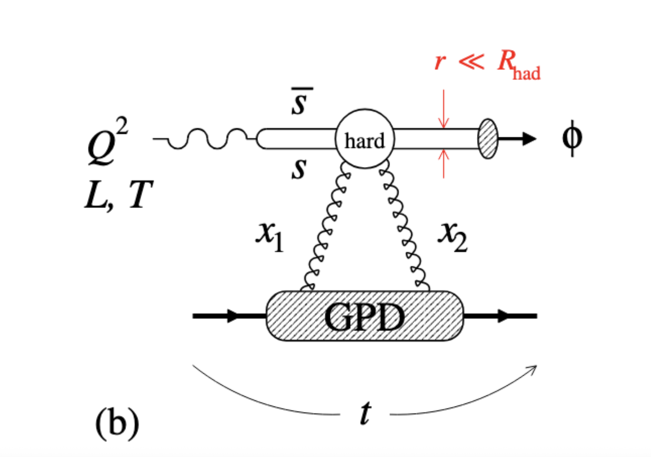
Motivations
Analysis objective :
Measurement of the cross section of the of ɸ electroproduction
on neutron in the K⁺ K⁻ channel with deuterium target.
e n → e n’ K⁺ K⁻
→
Access to the gluon content of the neutron
Change of t–dependence with Q2
→ gluonic radius of the neutron
Mathieu Ronayette
3/19
Mathieu Ronayette
RGB Meeting
22 May 2026

Slide 4
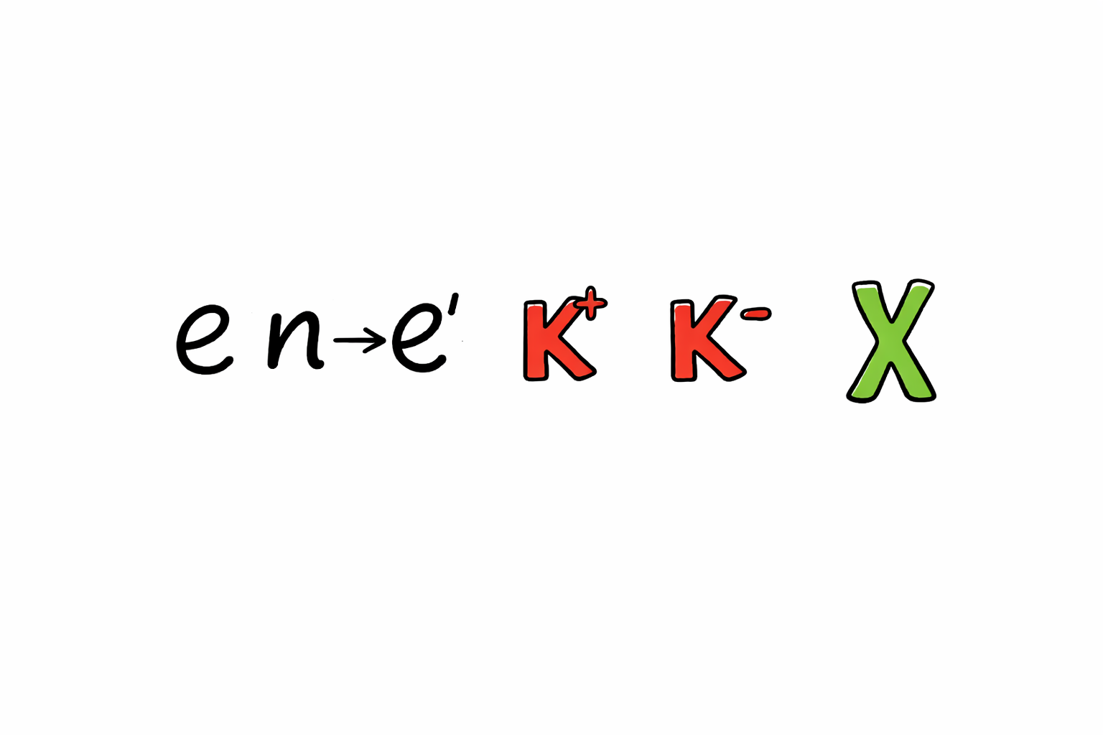
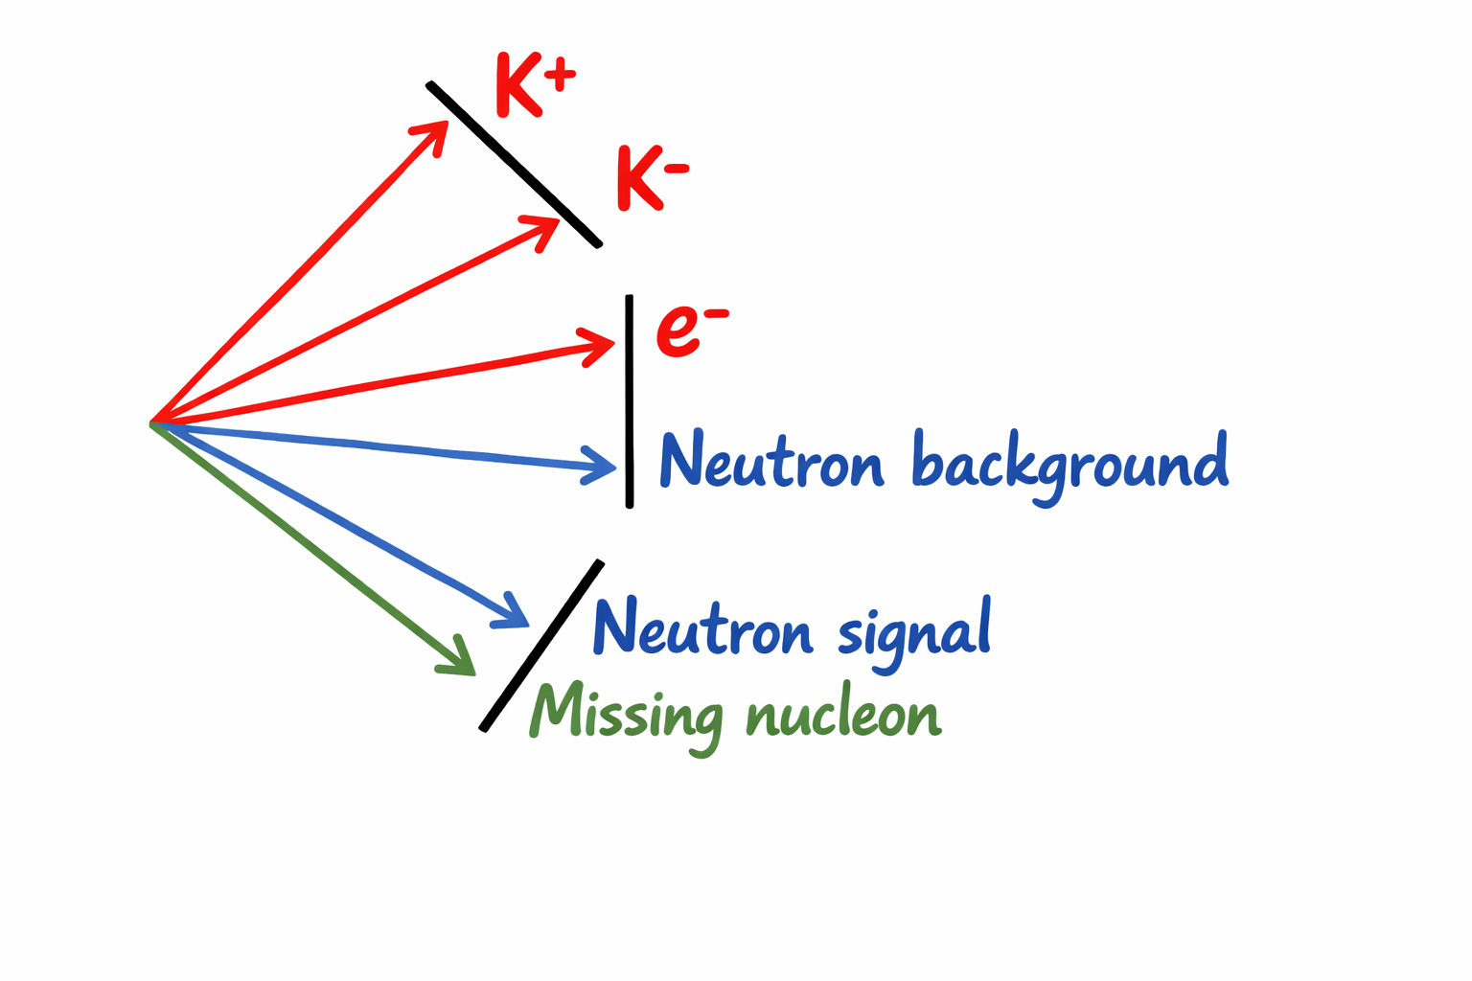
Events selection :
Select the best neutron wich minimize the angle between the missing nucleon and the neutron and verify that the angle θ between the missing nucleon and the neutron is less than 5 °. Also we need 0 proton detected to reduce contamination.
θ
Mathieu Ronayette
4/19
Mathieu Ronayette
RGB Meeting
22 May 2026

Slide 5
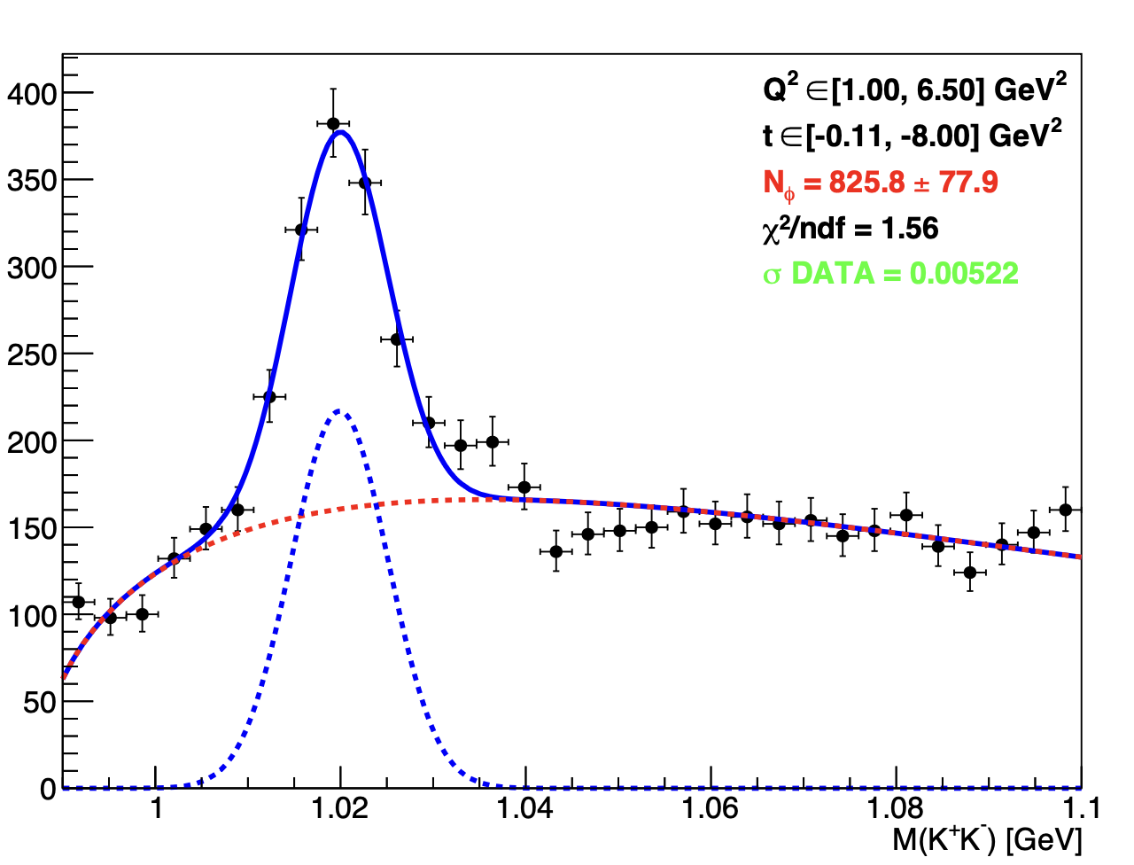
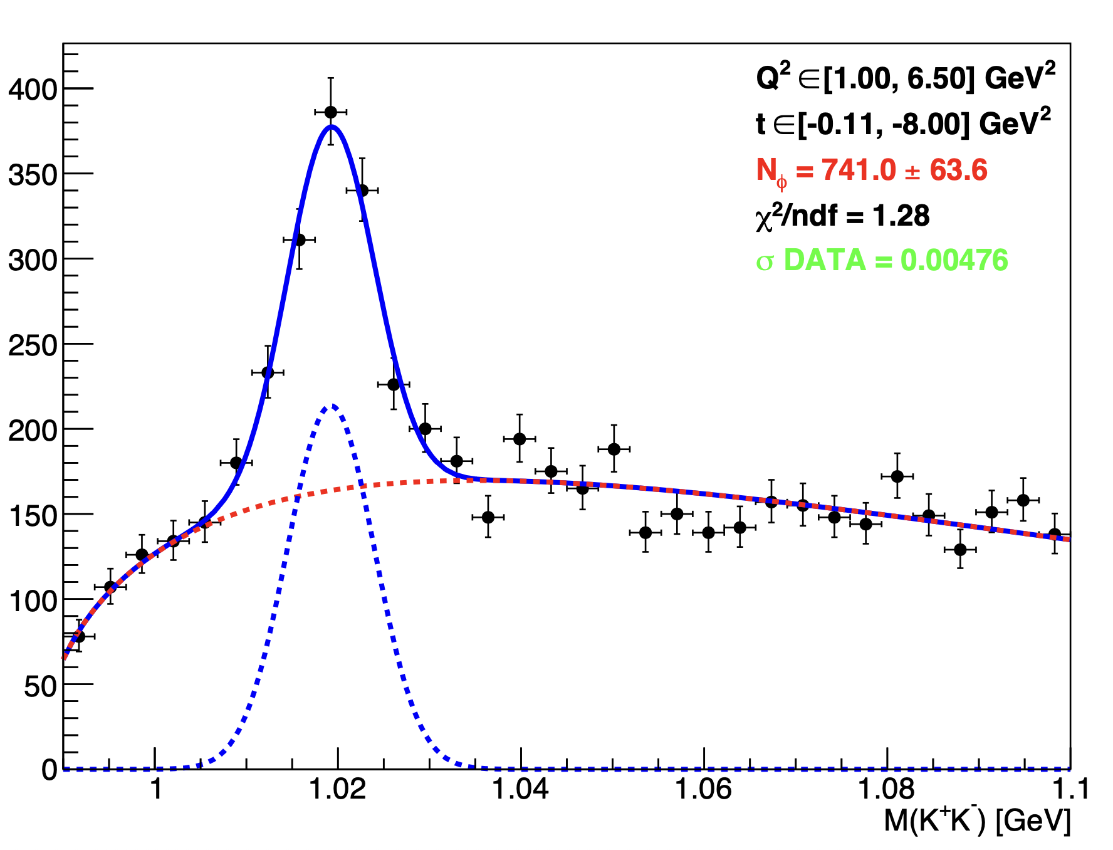
Update on dataset : look spring2020
Fall2019 outbending
Spring2020 inbending
Q = 12.1 mC
Q = 28.3 mC
Mathieu Ronayette
5/19
Mathieu Ronayette
RGB Meeting
22 May 2026

Slide 6
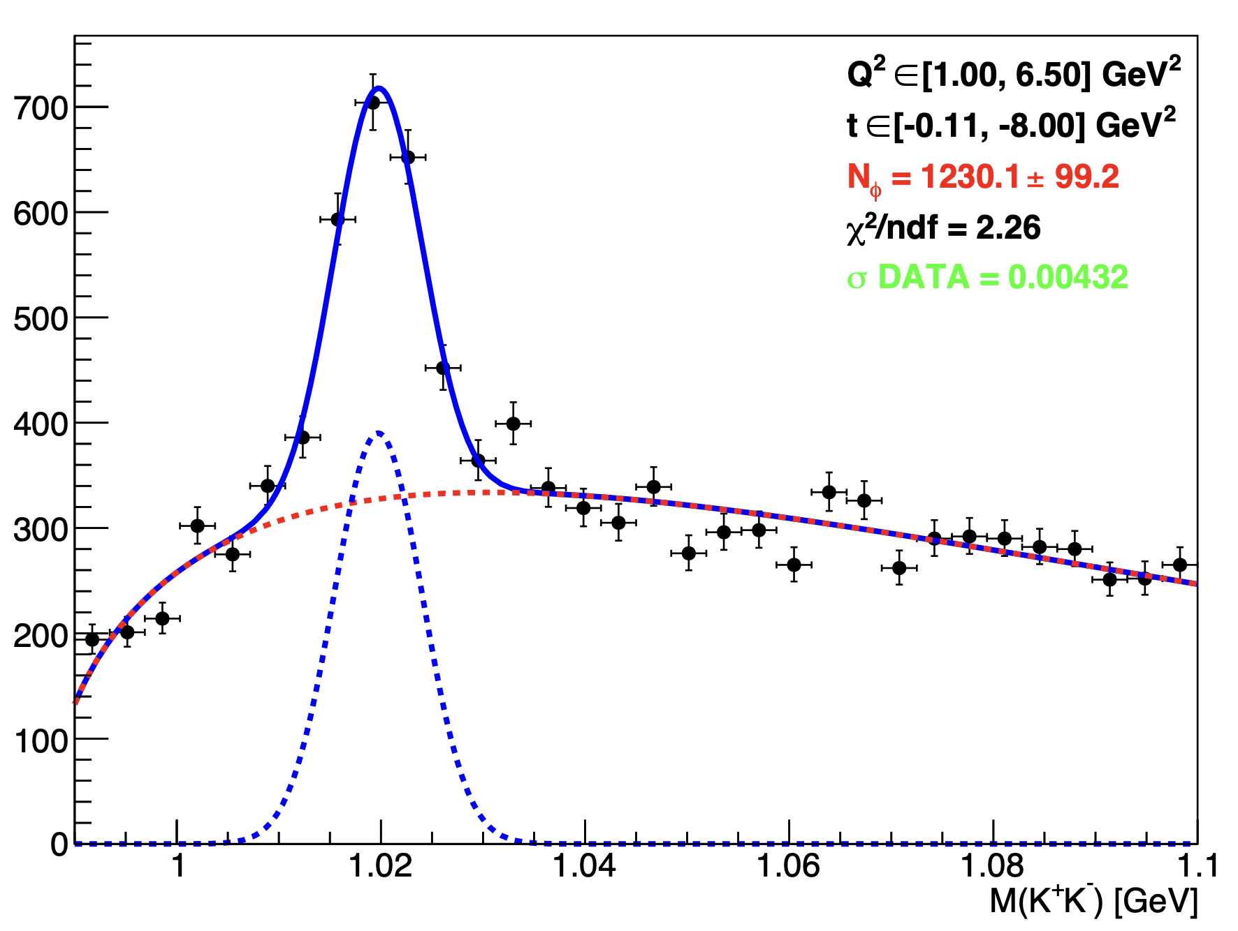
Update on dataset : look spring2019
Spring 2019 inbending
Q = 63.4 mC
Mathieu Ronayette
6/19
Mathieu Ronayette
RGB Meeting
22 May 2026

Slide 7
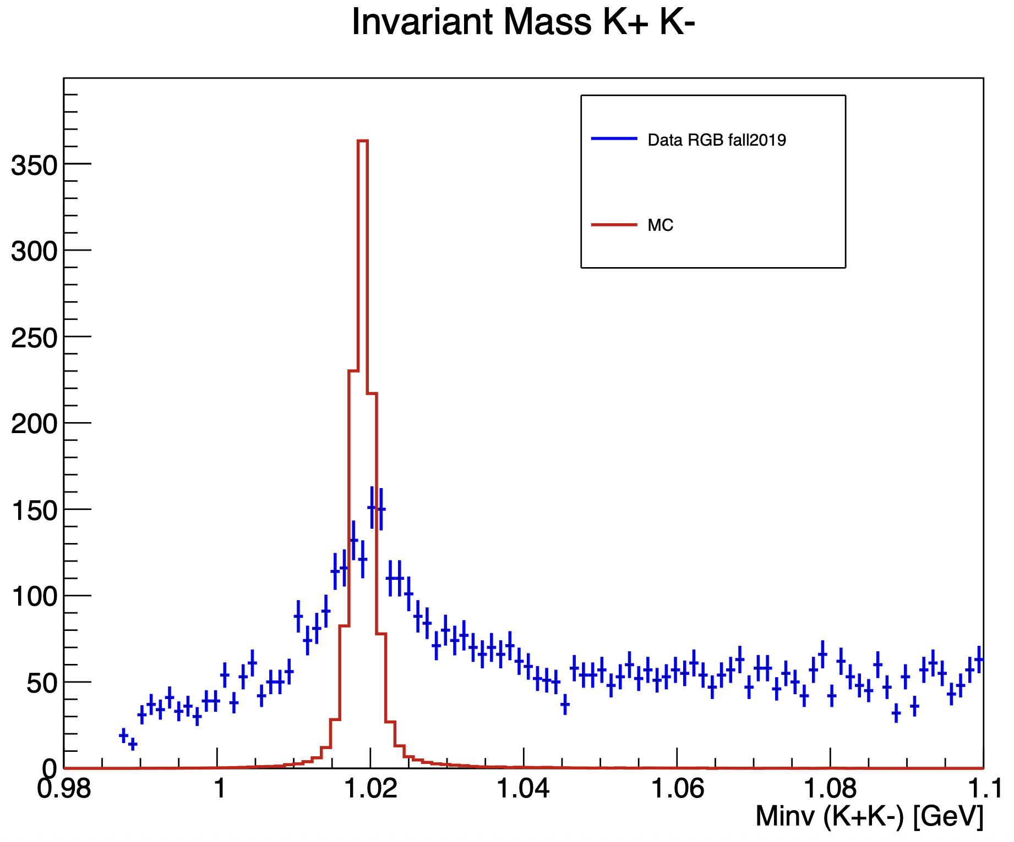
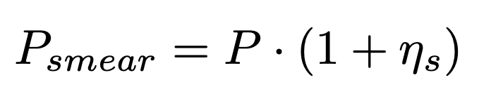
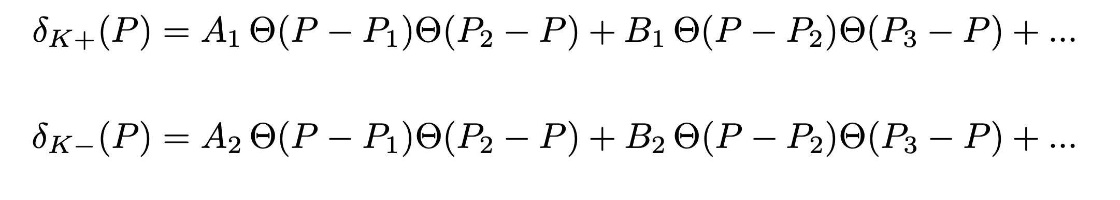
Smearing of the kaons
→ We need a smearing of both kaons in the MC
→ Minimize σ_{DATA} - σ_{MC} per bins of momentum to find the parametters A₁, B₁, C₁ ….
Mathieu Ronayette
7/19
Mathieu Ronayette
RGB Meeting
22 May 2026

Slide 8
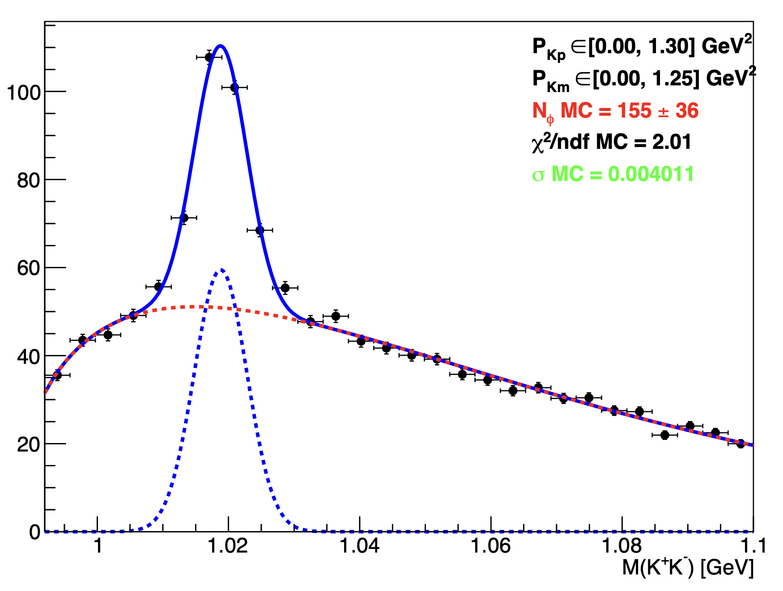
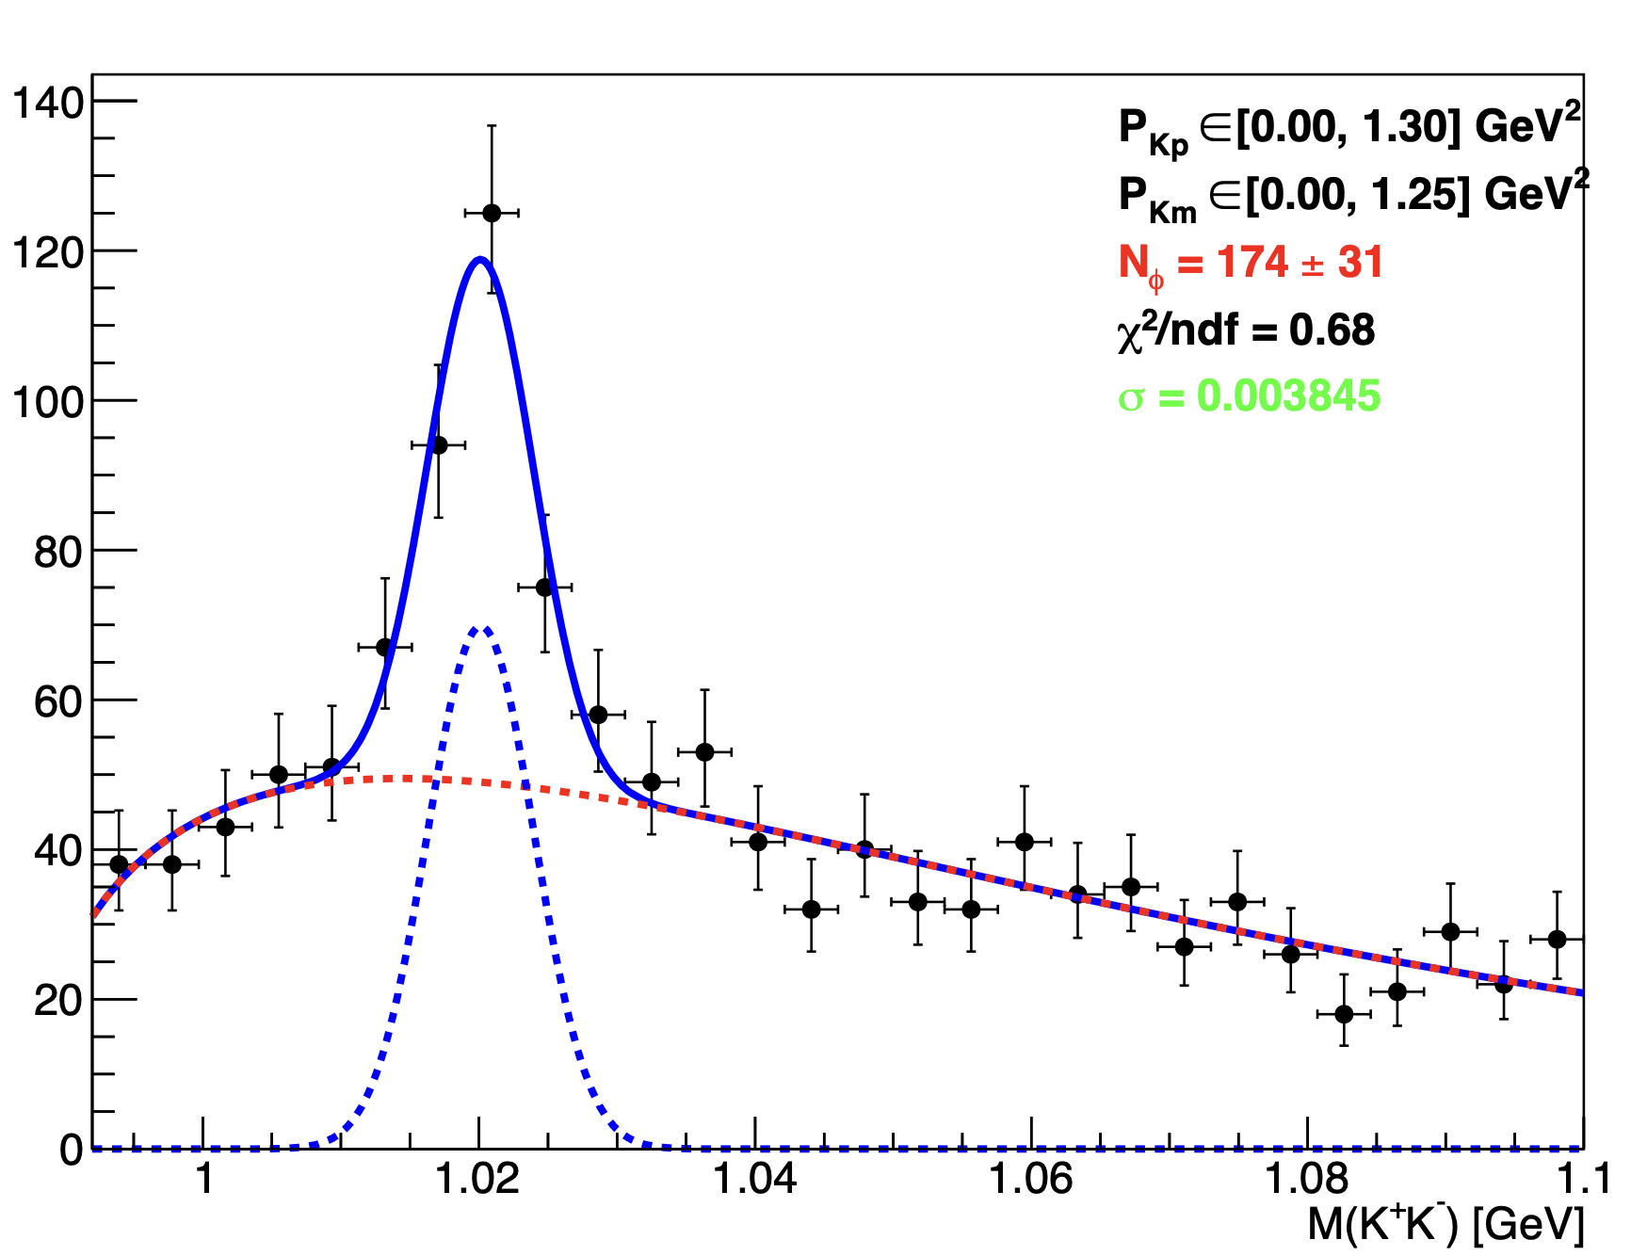
Smearing of the kaons
Random fill from the MC
reconstructed event histogram (with the smearing wich depends of the parametters A₁, B₁, C₁ … )
How to extrat σ_{MC} in one bin of momemtum?
Random fill from the
distribution of data
background
DATA
MC
Mathieu Ronayette
8/19
Mathieu Ronayette
RGB Meeting
22 May 2026

Slide 9
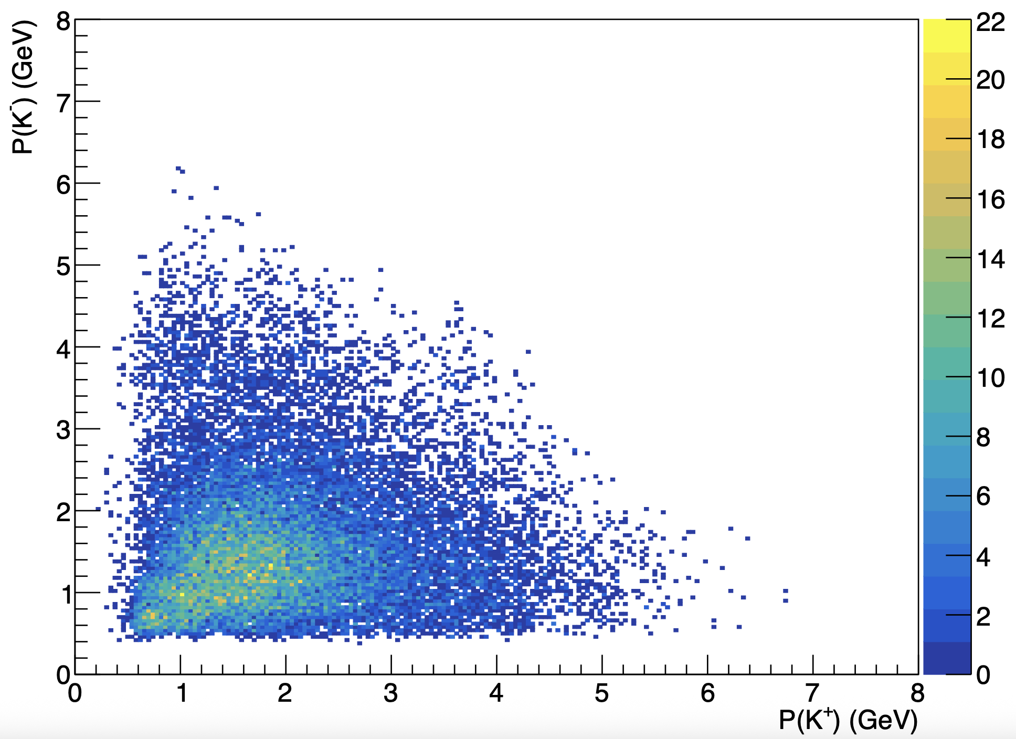
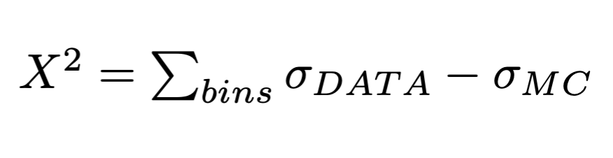
Smearing of the kaons
Extract σ_{DATA} and σ_{MC} per bins
→ Minimise X² with Minuit2 (Simplex) and find 8 parametters A1, B1, C1, D1, A2, B2, C2, and D2 of the smearing functions
Mathieu Ronayette
9/19
Mathieu Ronayette
RGB Meeting
22 May 2026

Slide 10
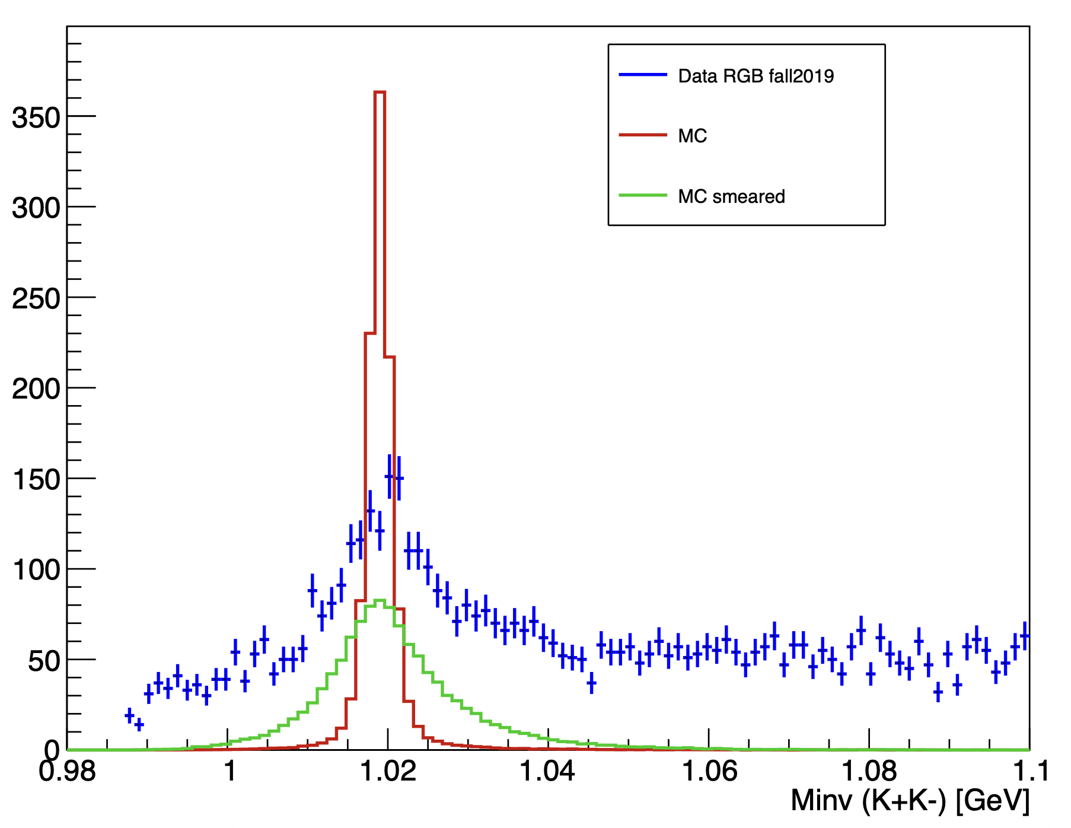
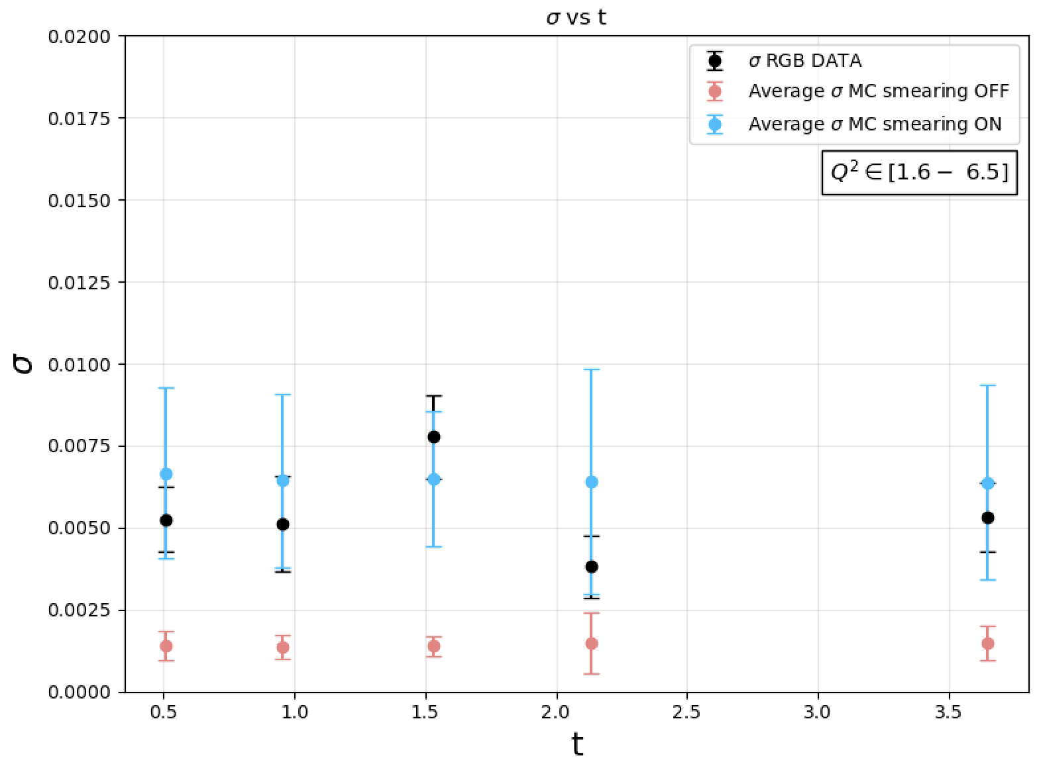
Smearing of the kaons
Mathieu Ronayette
10/19
Mathieu Ronayette
RGB Meeting
22 May 2026

Slide 11
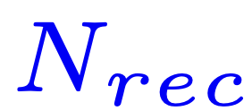
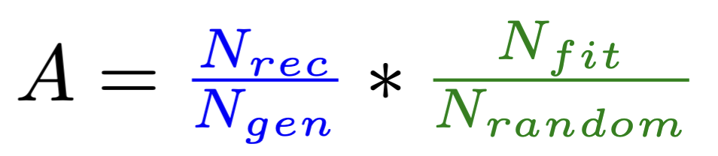
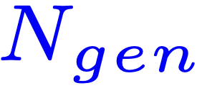
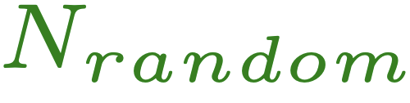
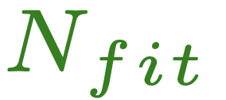
Update on the acceptance : new method
: Number of reconstructed event
in the MC
: Number of generated event
in the MC
: Number of event random fill from the MC reconstructed histogram (equal the number of phi extracted in the data)
Contribution from the model, the geometry and the efficiency.
Contribution from the resolution of the fit.
: Number of extracted event
with the fit (average of 10000 pseudo-exp)
Mathieu Ronayette
11/19
Mathieu Ronayette
RGB Meeting
22 May 2026

Slide 12
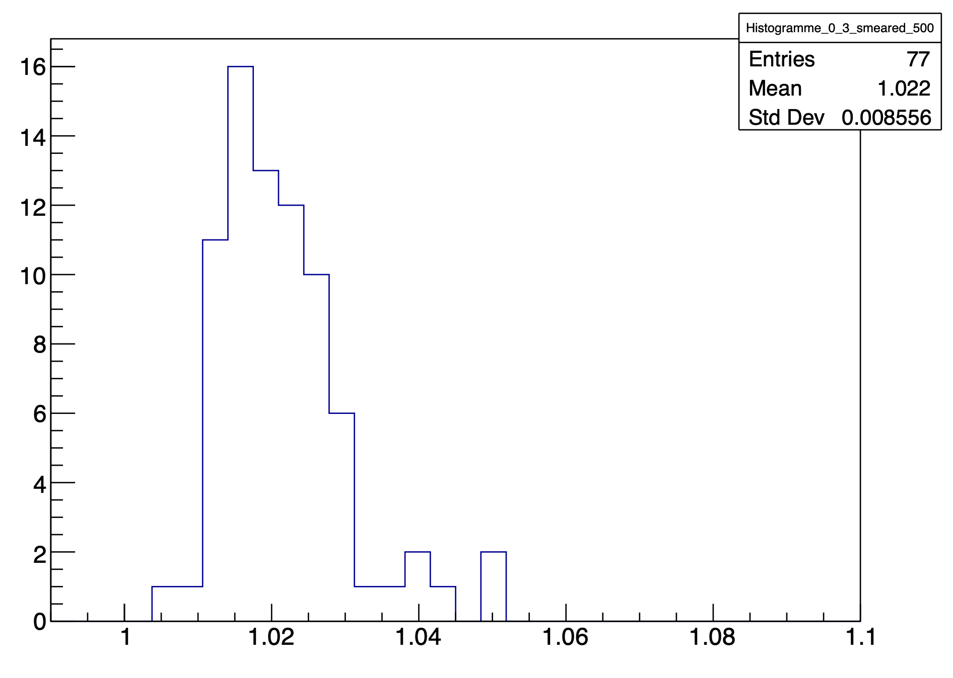
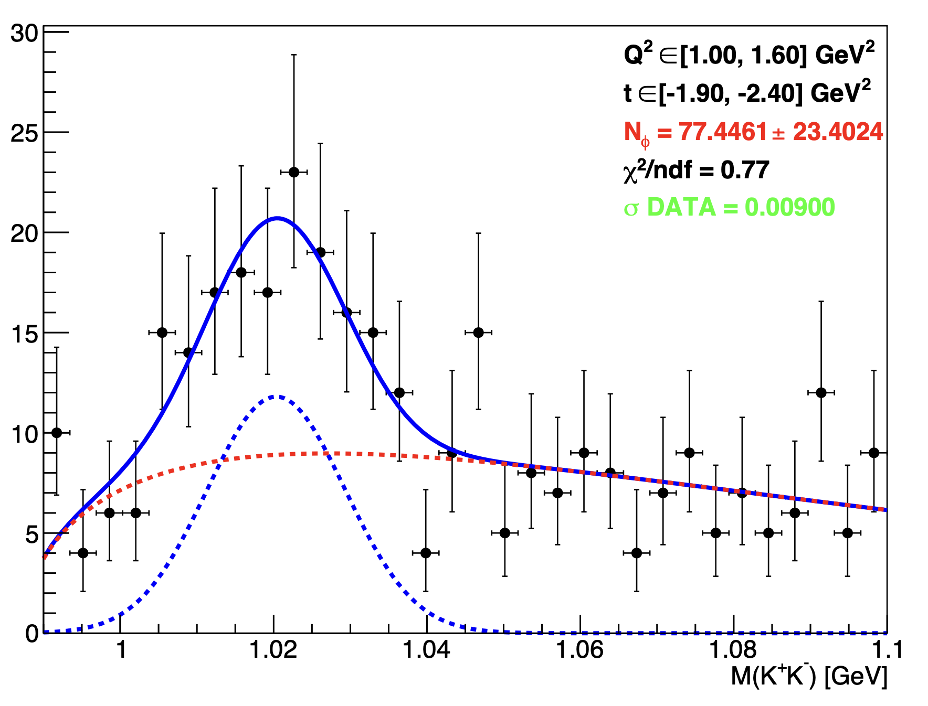
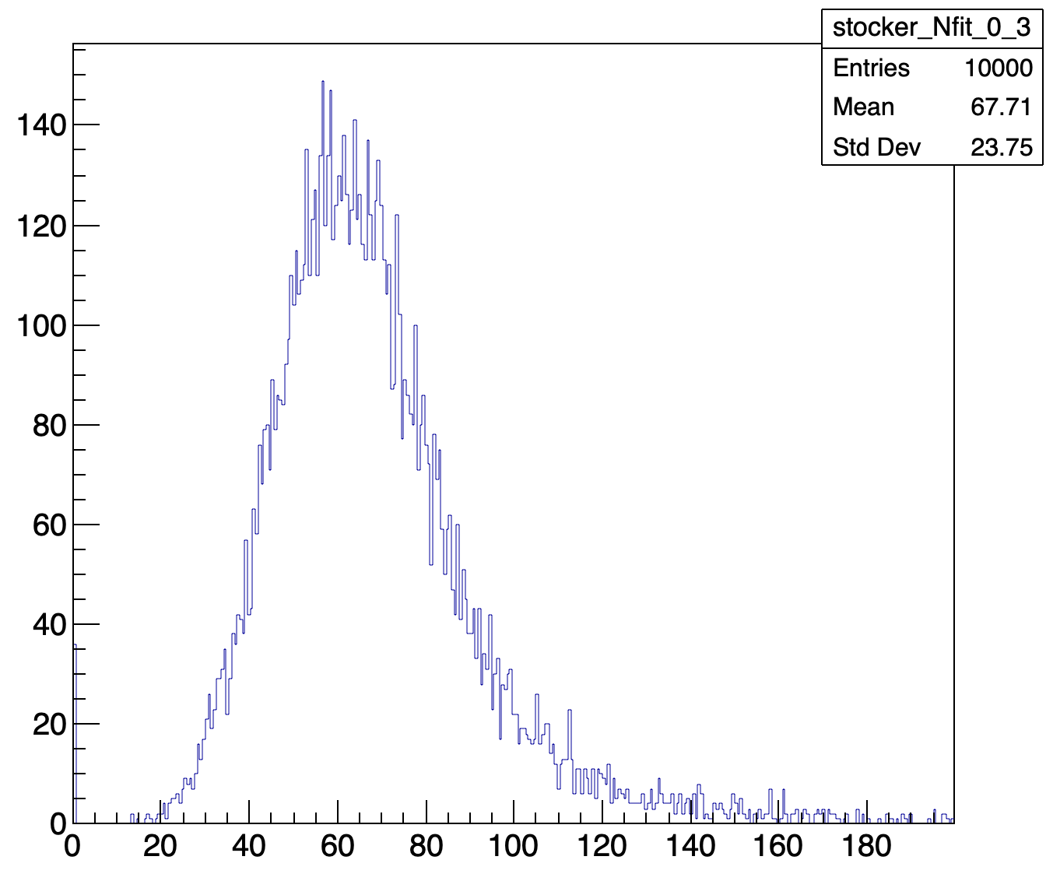
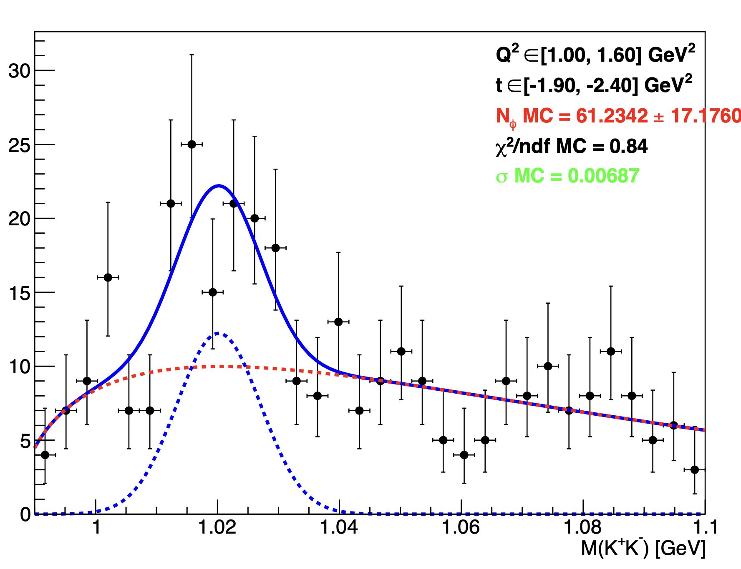
Update on the acceptance : new method
Random fill (with N_{random} equal to the number of ɸ in the data) from the MC reconstructed histogram.
N_{fit}
x 10 000
DATA
Random fill from the distribution of data background
Pseudo-exp
Mathieu Ronayette
12/19
Mathieu Ronayette
RGB Meeting
22 May 2026

Slide 13
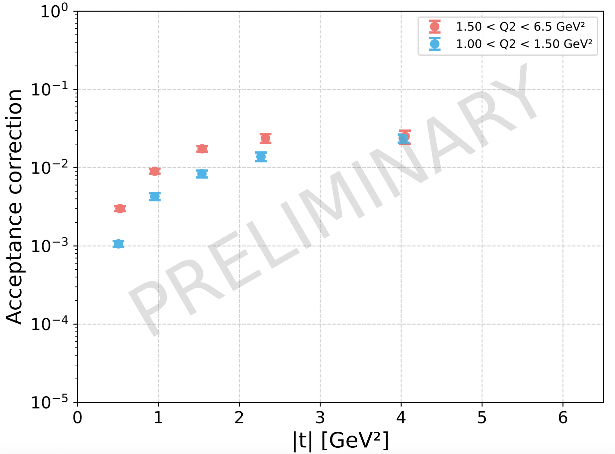
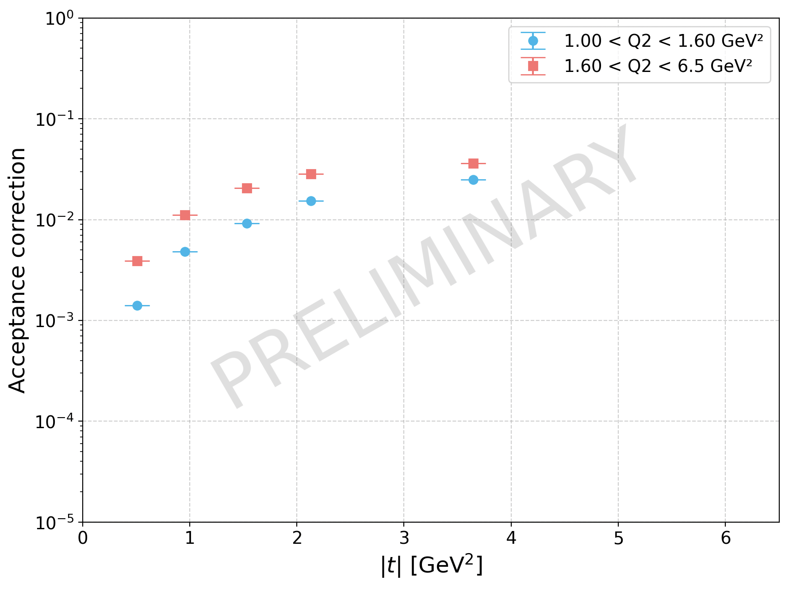
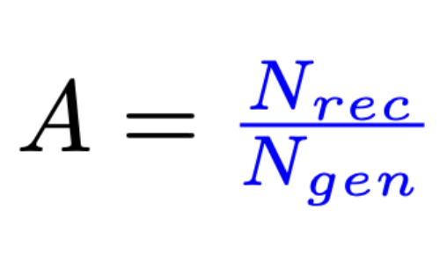
Update on the acceptance : new method
With the previous method :
With new method :
(and smearing)
Mathieu Ronayette
13/19
Mathieu Ronayette
RGB Meeting
22 May 2026

Slide 14
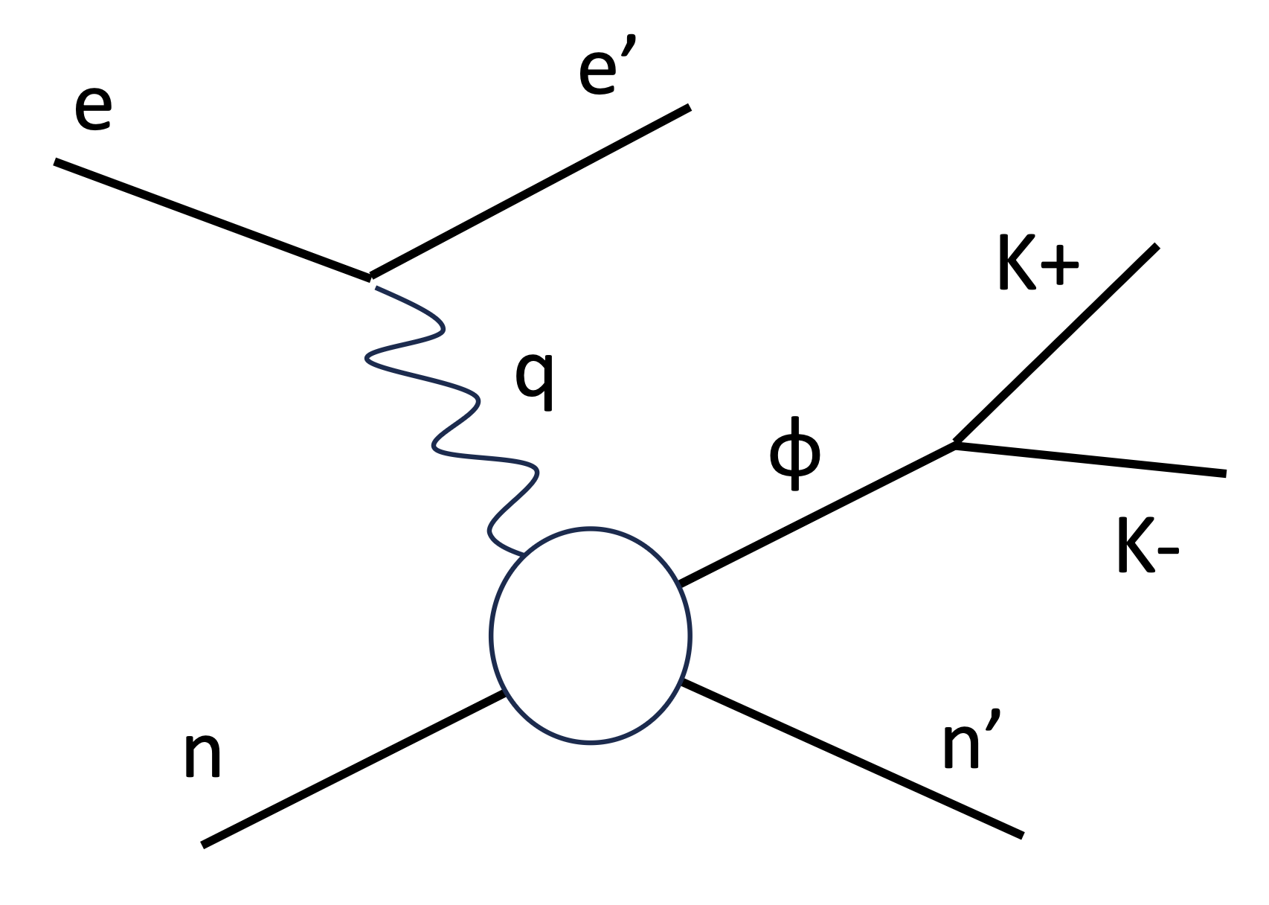
Include SDME in the simulation
Q²
K+
_{K+}
ɸ
W
K-
Non isotropic decay of the kaons in the ɸ frame. So we need to add a weight associated to the SDME
t
Mathieu Ronayette
14/19
Mathieu Ronayette
RGB Meeting
22 May 2026

Slide 15
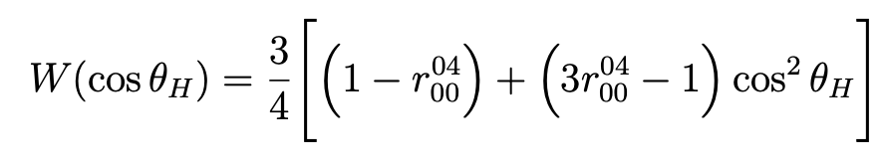
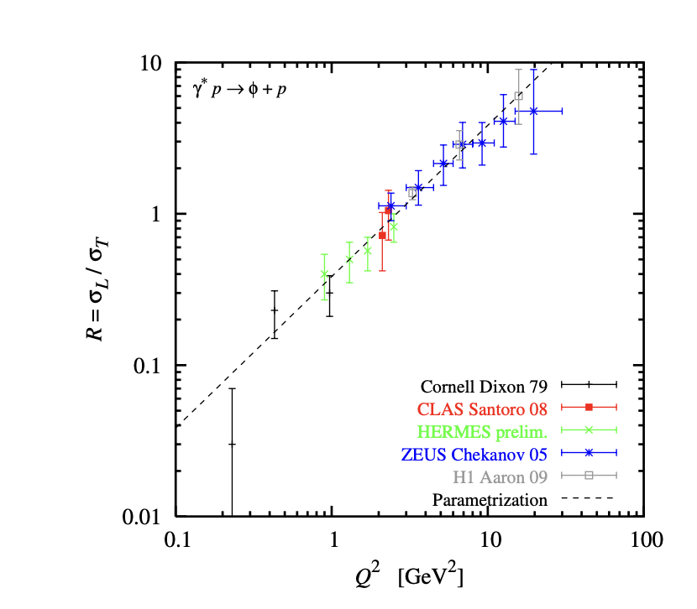
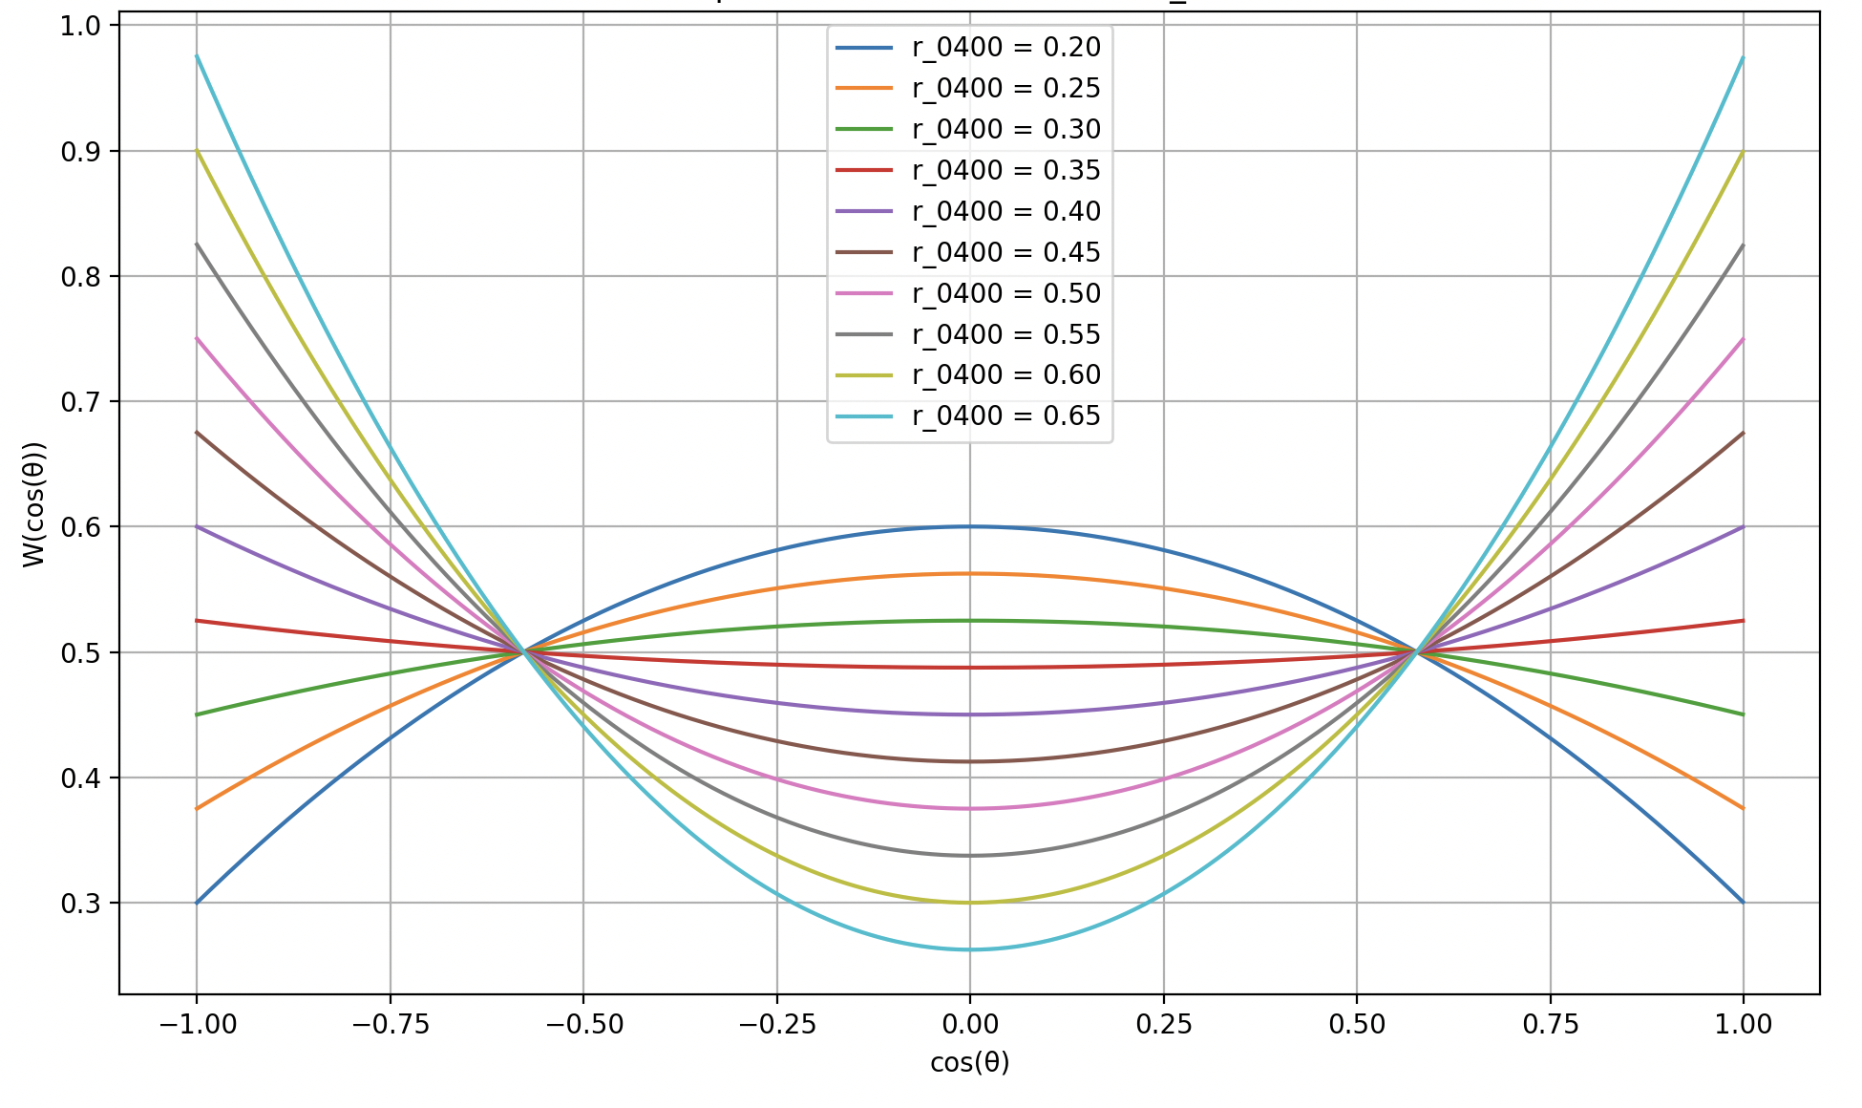
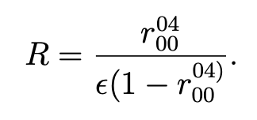
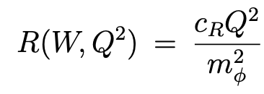
Include SDME in the simulation
From Proposal to Jeﬀerson Lab PAC39 Exclusive Phi Meson Electroproduction with CLAS12
Mathieu Ronayette
15/19
Mathieu Ronayette
RGB Meeting
22 May 2026

Slide 16
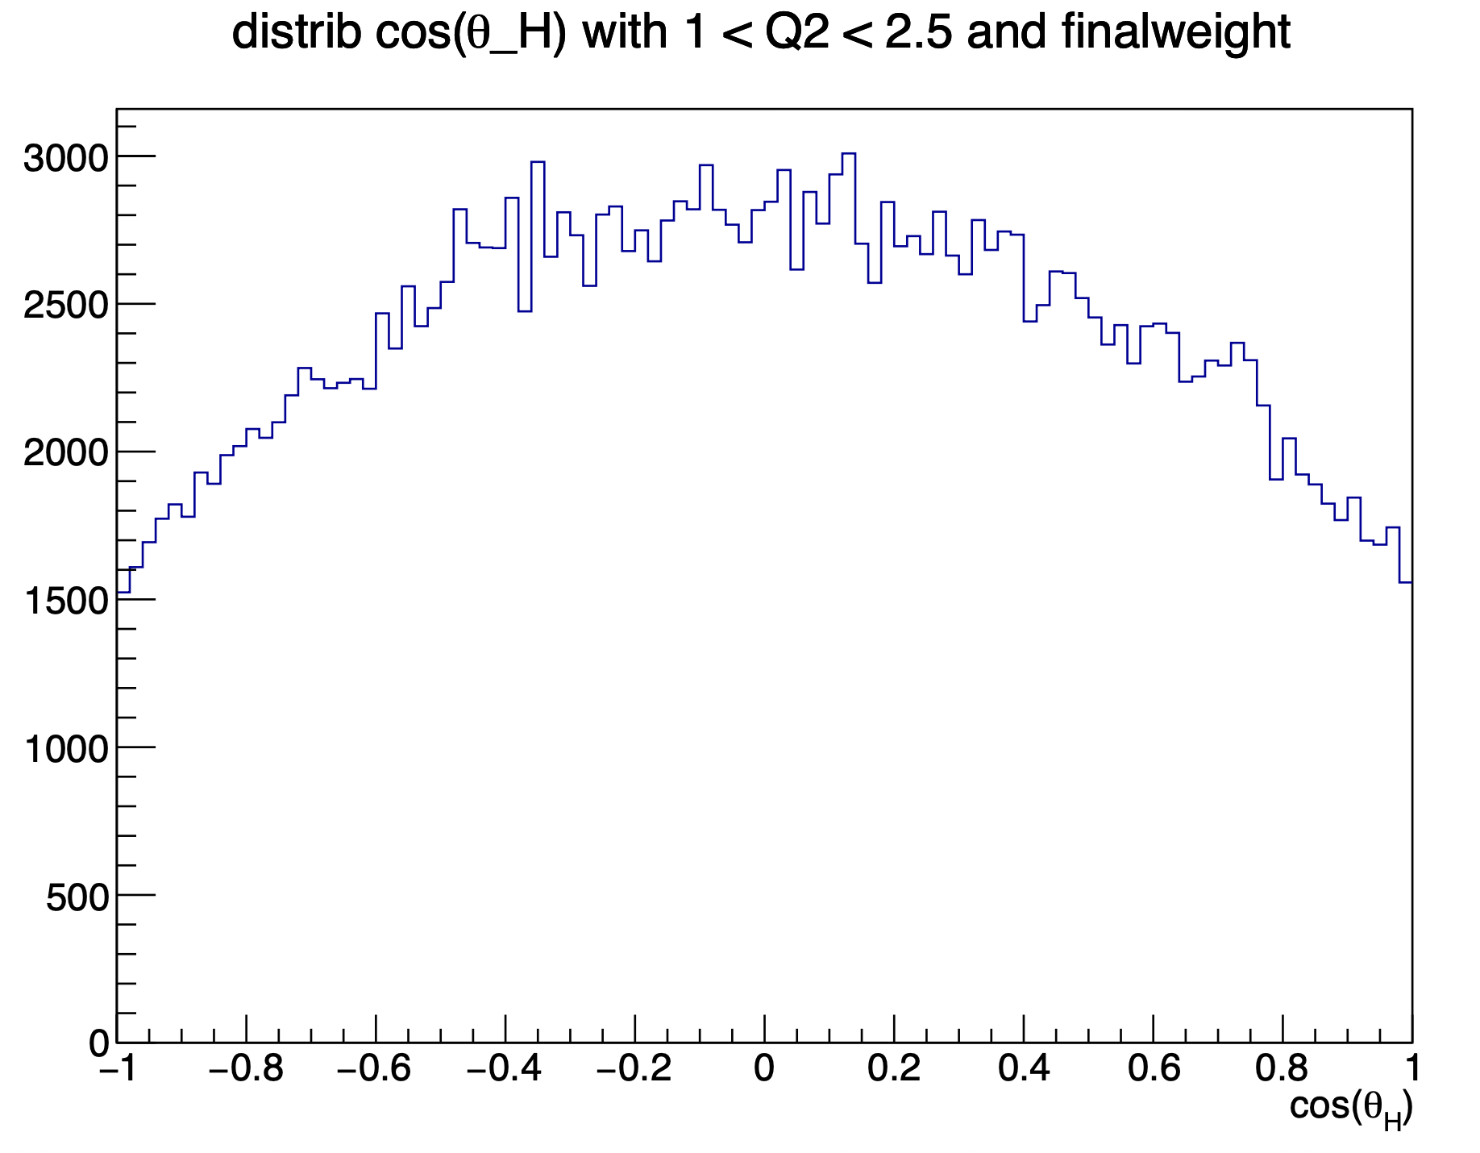
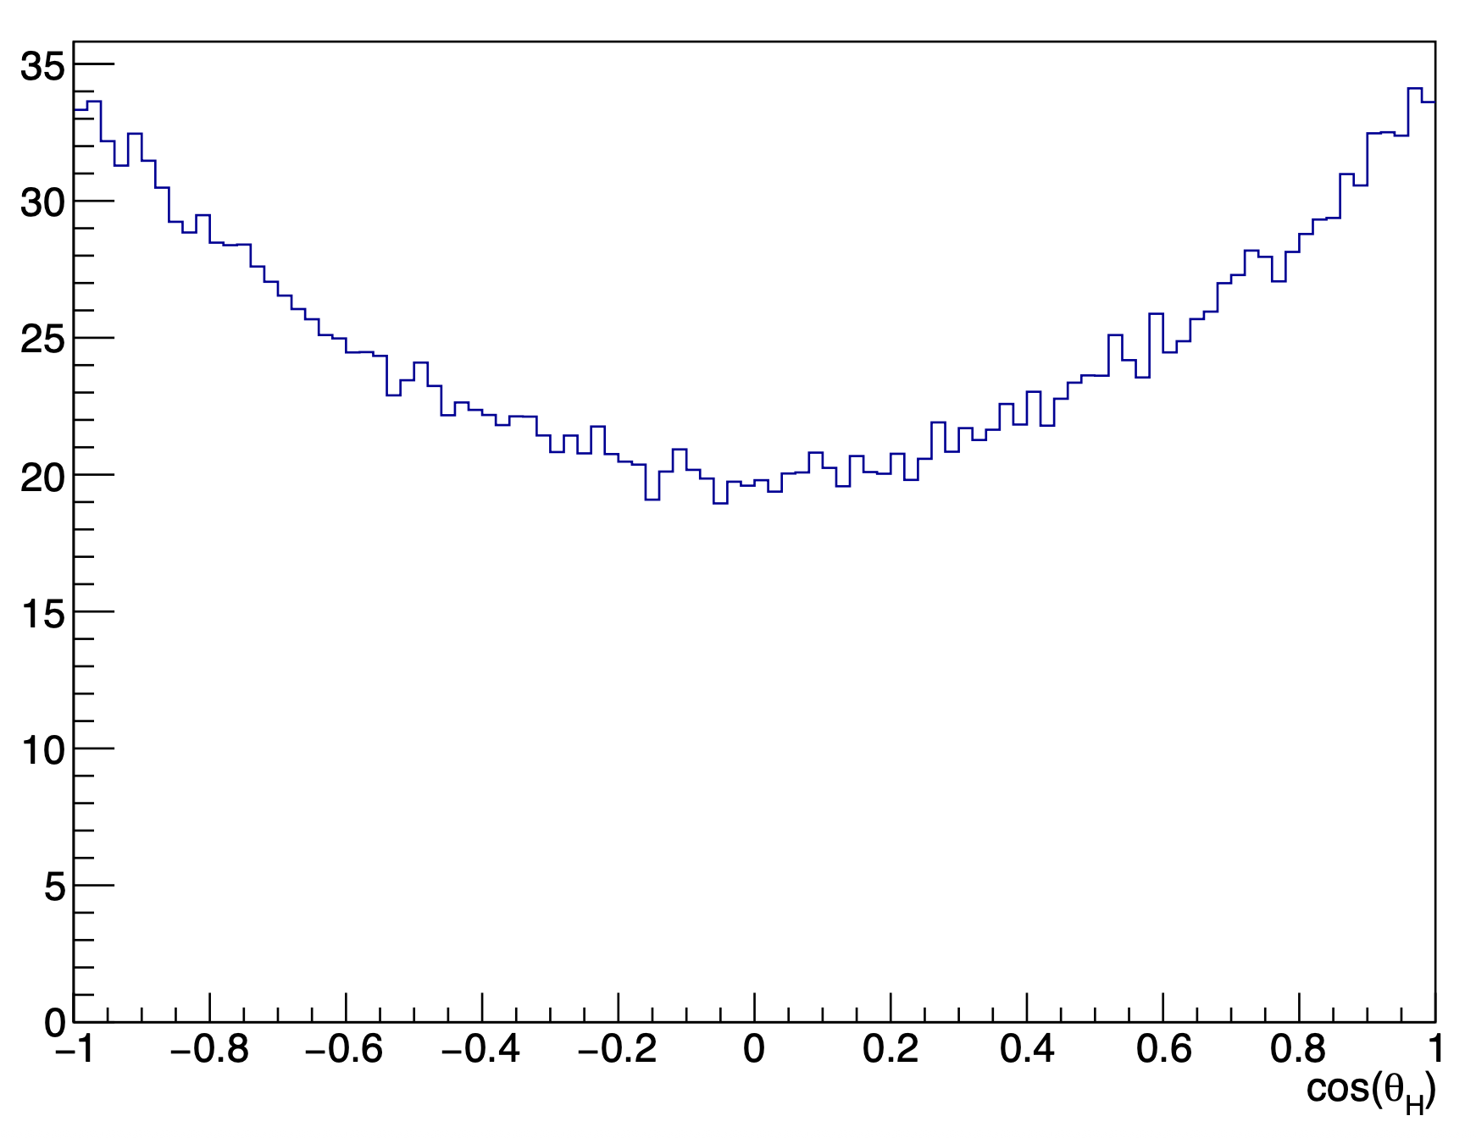
Include SDME in the simulation (generated plots)
With Q² in [1.0 – 1.5] GeV²
With Q² in [5.0 – 6.5] GeV²
Mathieu Ronayette
16/19
Mathieu Ronayette
RGB Meeting
22 May 2026

Slide 17
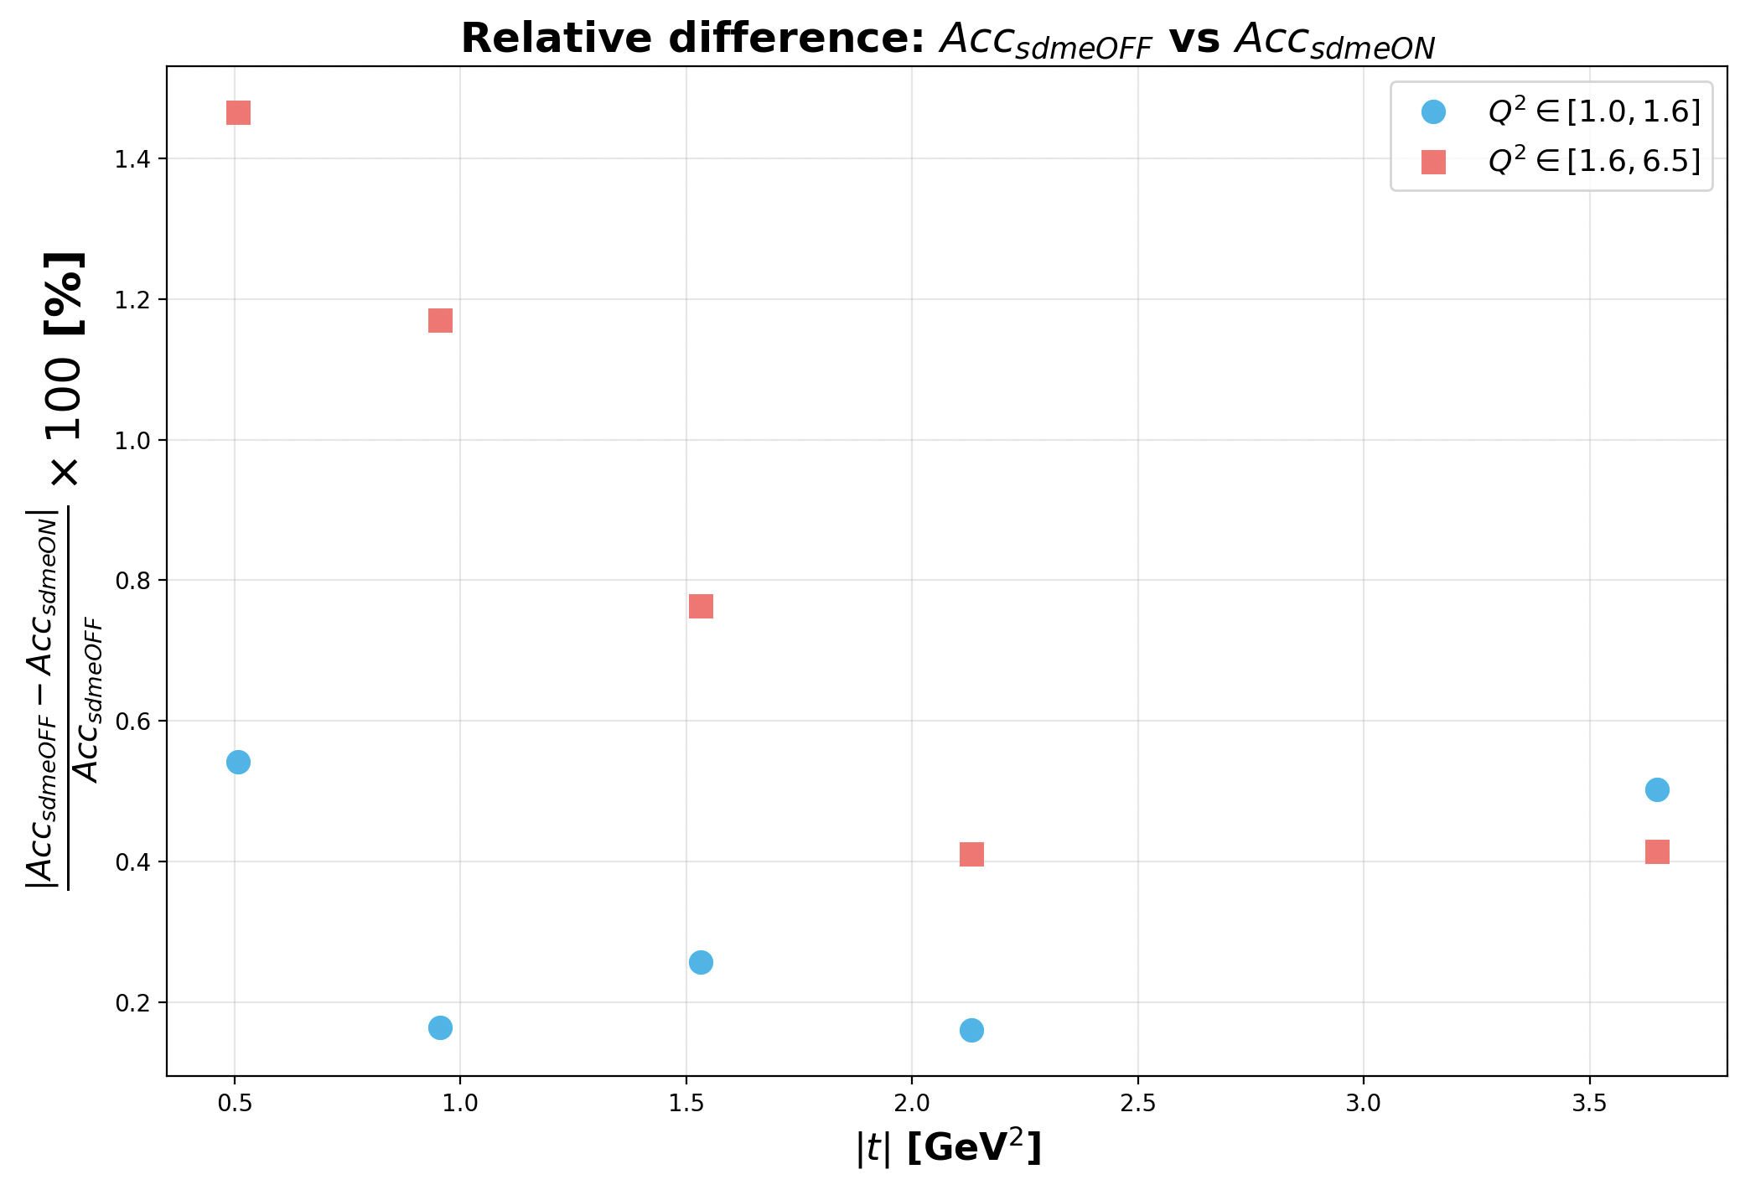
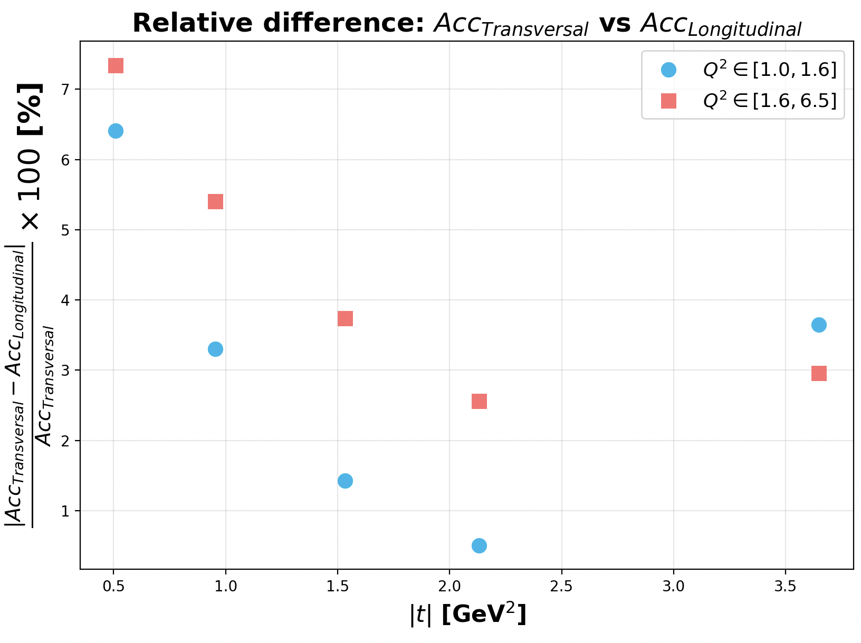
Impact on the acceptance
Impact < 1.5 % on the acceptance between no SDME and a classical model of SDME
Impact < 7.5 % between two different models of SDME (longitudinal or transversal favorised distributions)
Mathieu Ronayette
17/19
Mathieu Ronayette
RGB Meeting
22 May 2026

Slide 18
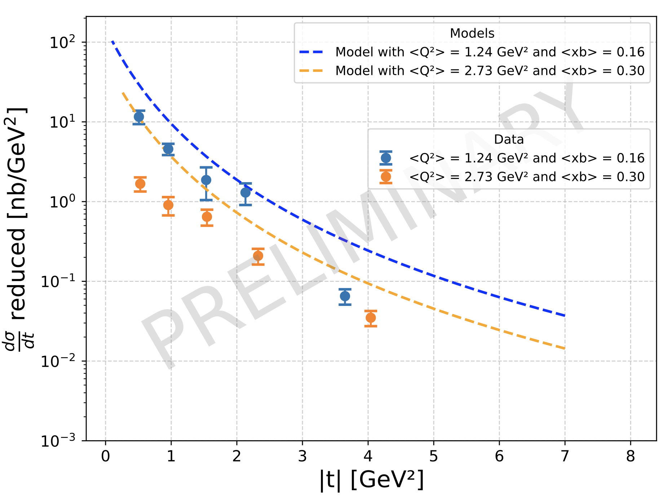
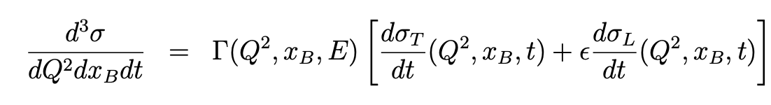
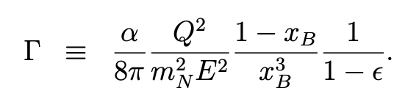

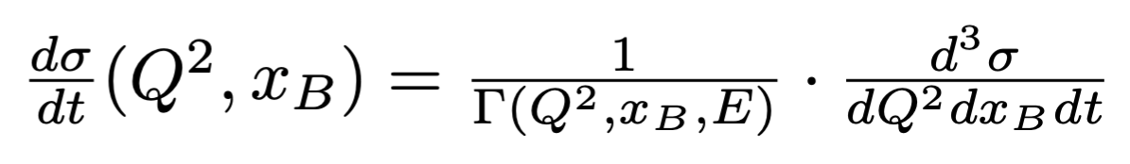
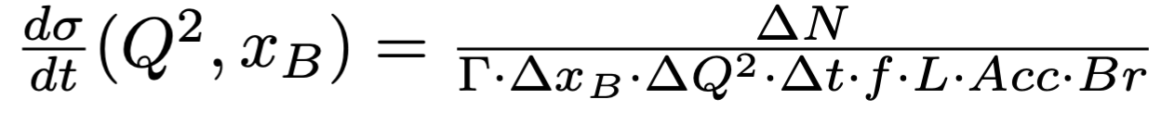
Preliminary differential cross section with all update
Mathieu Ronayette
18/19
Mathieu Ronayette
Clas12 Collaboration Meeting
12 March 2026

Slide 19
Conclusion and outlook
Next steps in the ɸ analysis :
- Improve the MC simulations (fermi motion, efficiency corrections for the kaons...)
Develop momentum corrections for the kaons.
Thanks!
Mathieu Ronayette
22 May 2026
19/19
Mathieu Ronayette
RGB Meeting

Slide 20
Backup
Backup slides
Mathieu Ronayette
20/20
Mathieu Ronayette
Clas12 Collaboration Meeting
11 March 2026

Slide 21
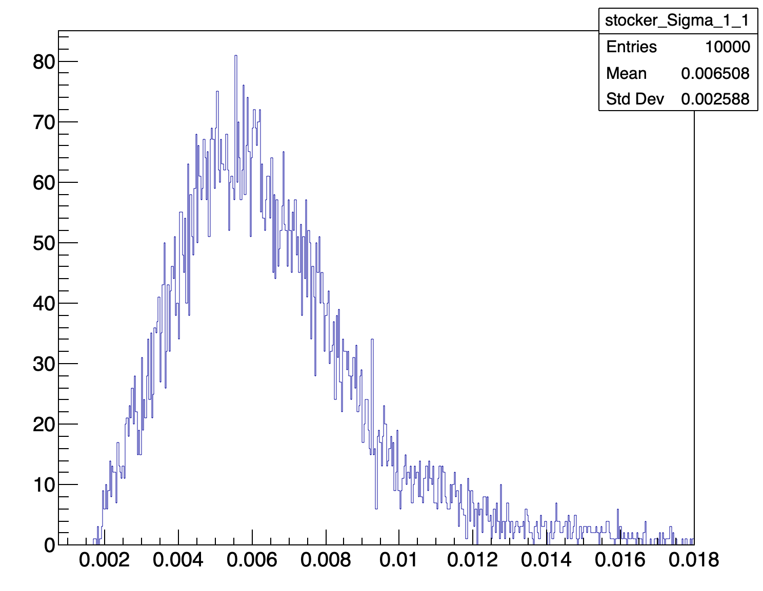
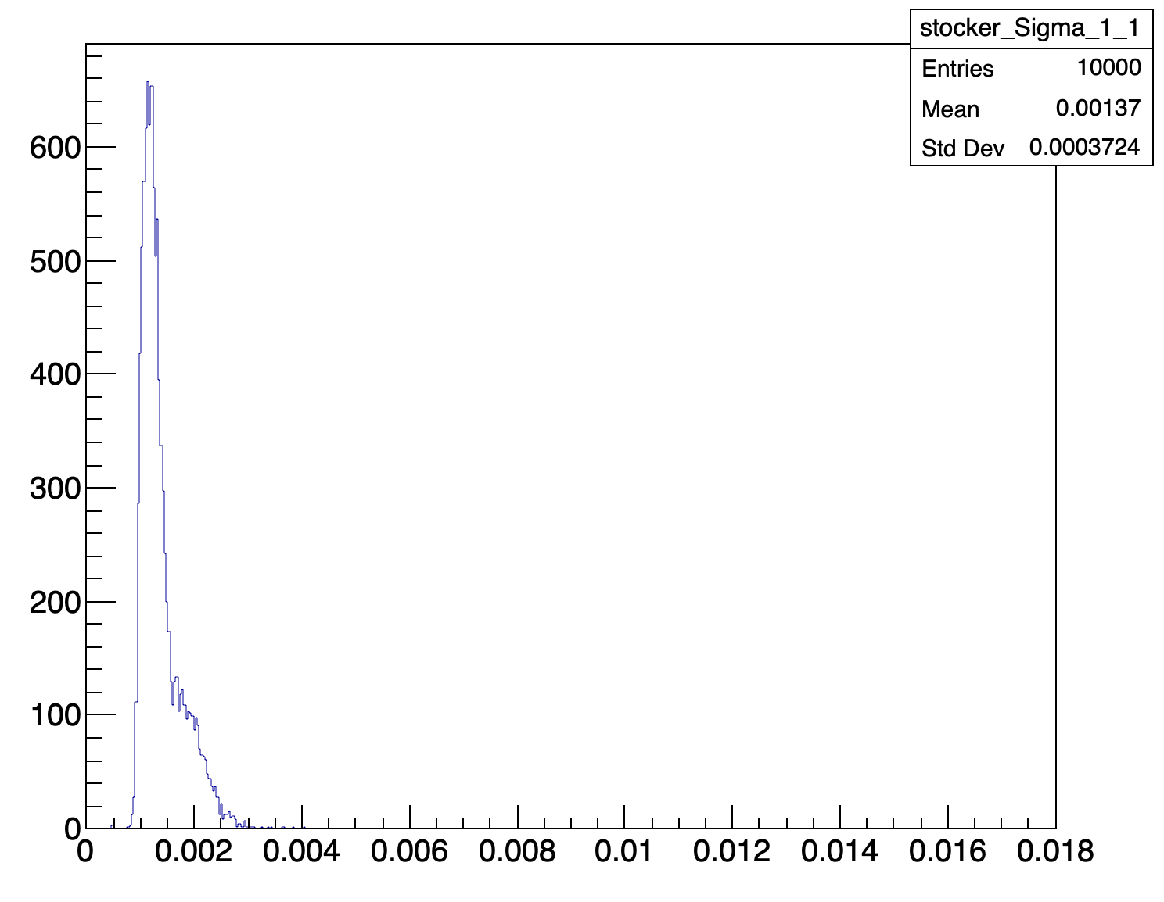
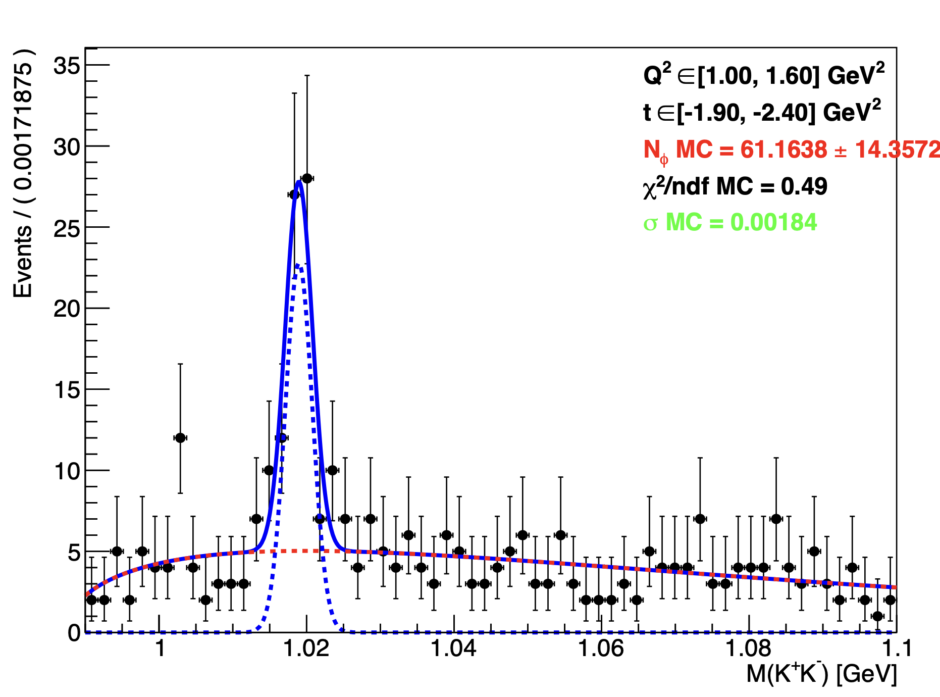
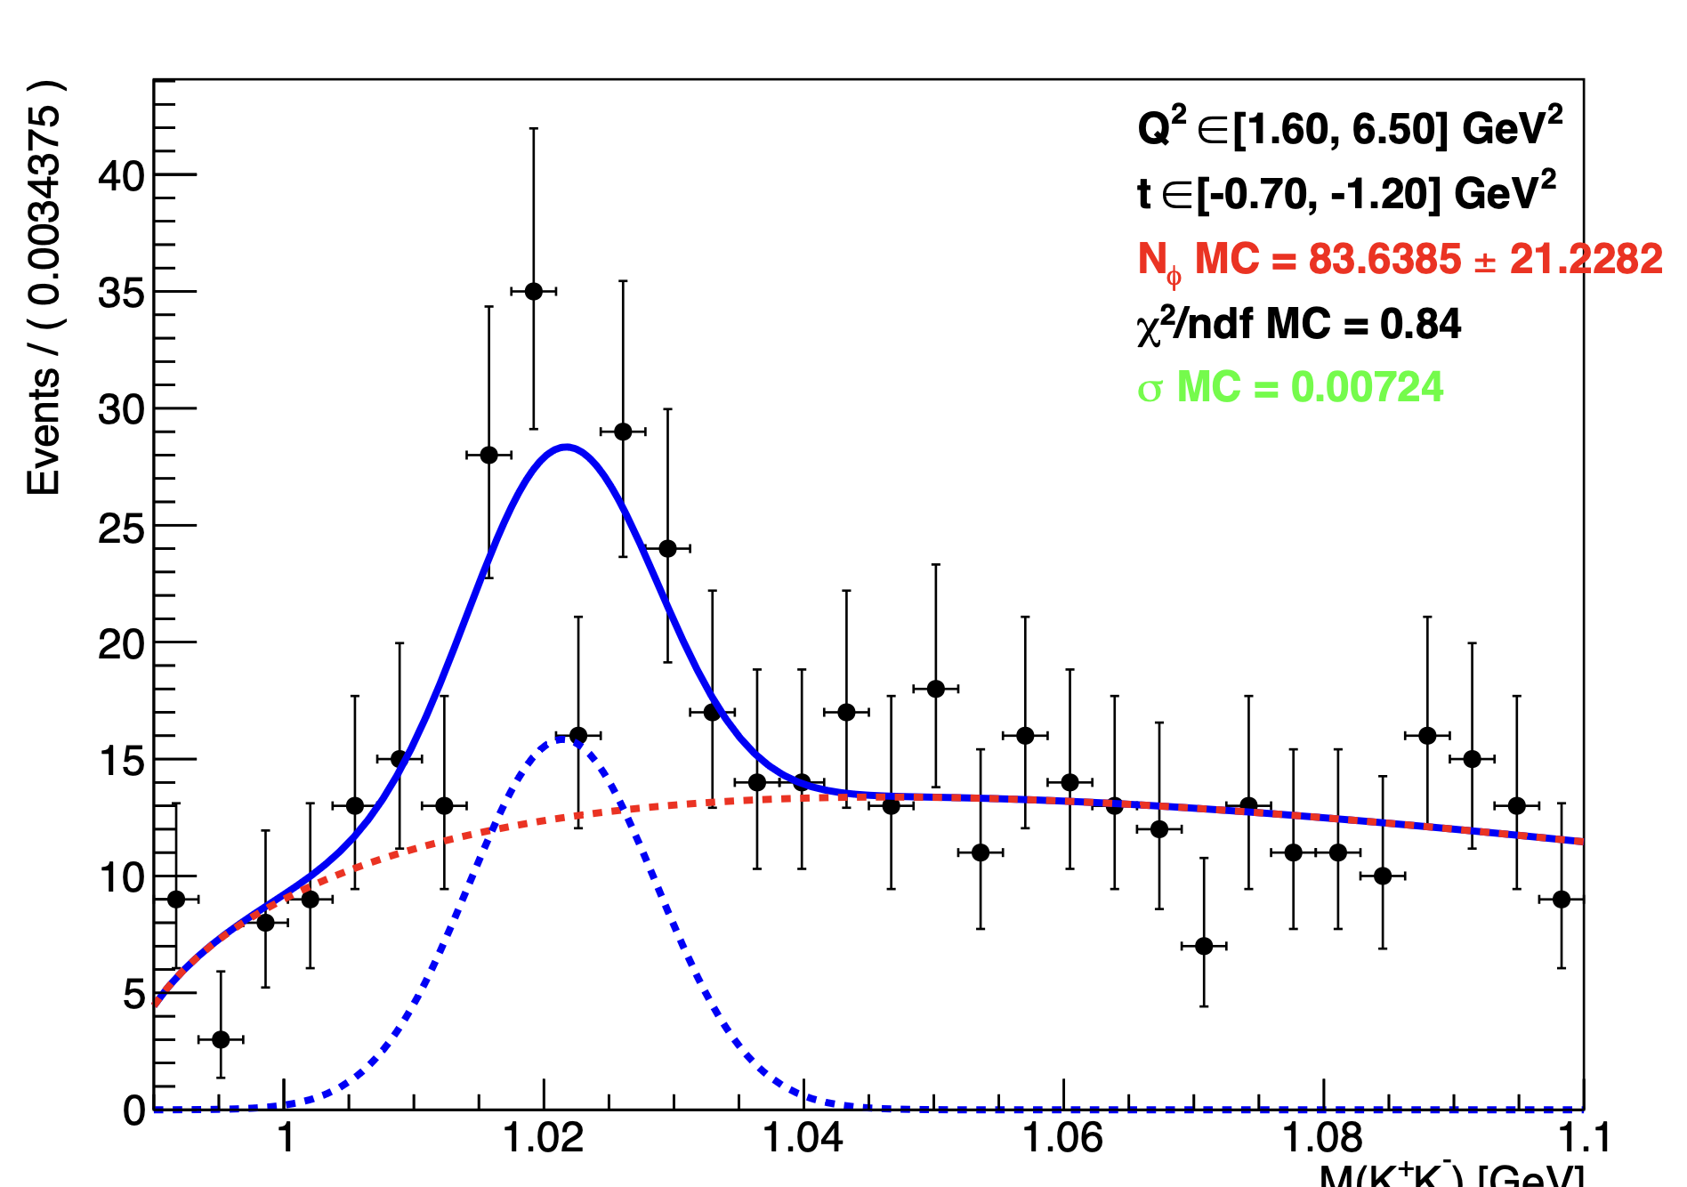
Precision on error bar slide 10
To calculate σ MC before and after smearing we did 10 000 pseudo-exp like explain slide 12. So we obtain a «gaussian» of value of σ. The error bar correspond to size of the gaussian.
Smearing ON
Smearing OFF
Sigma distrib
Sigma distrib
But why the errorbar are different before and after smearing ? Before smearing, there is a greater signal-to-background ratio because the signal is thinner. After smearing, this ratio decrease and shape of the background has a greater impact.
Mathieu Ronayette
19/19
Mathieu Ronayette
RGB Meeting
22 May 2026

Slide 22
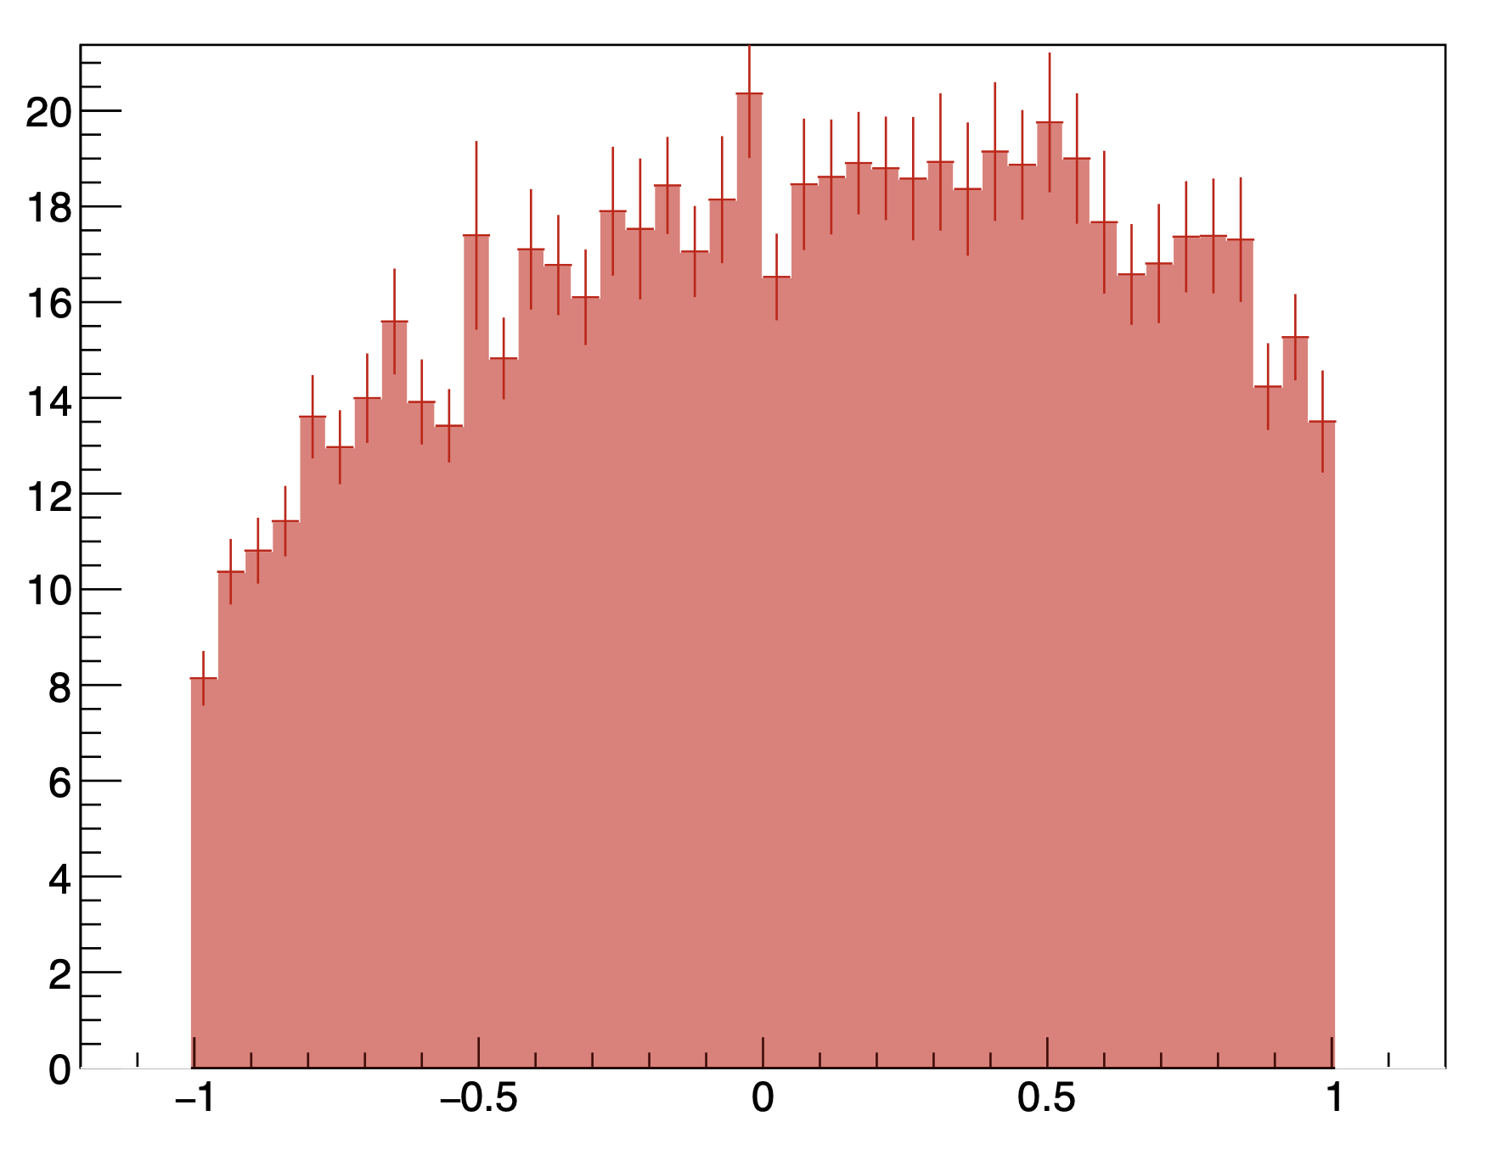
Include SDME in the simulation (reconstructed event)
Reconstructed with Q² in [1.0 – 1.5] GeV²
You can see acceptance effect when
you compare to the generated plot
cos(θ_{H})
Mathieu Ronayette
4/11
Mathieu Ronayette
LSN Meeting
10 April 2026

Slide 23
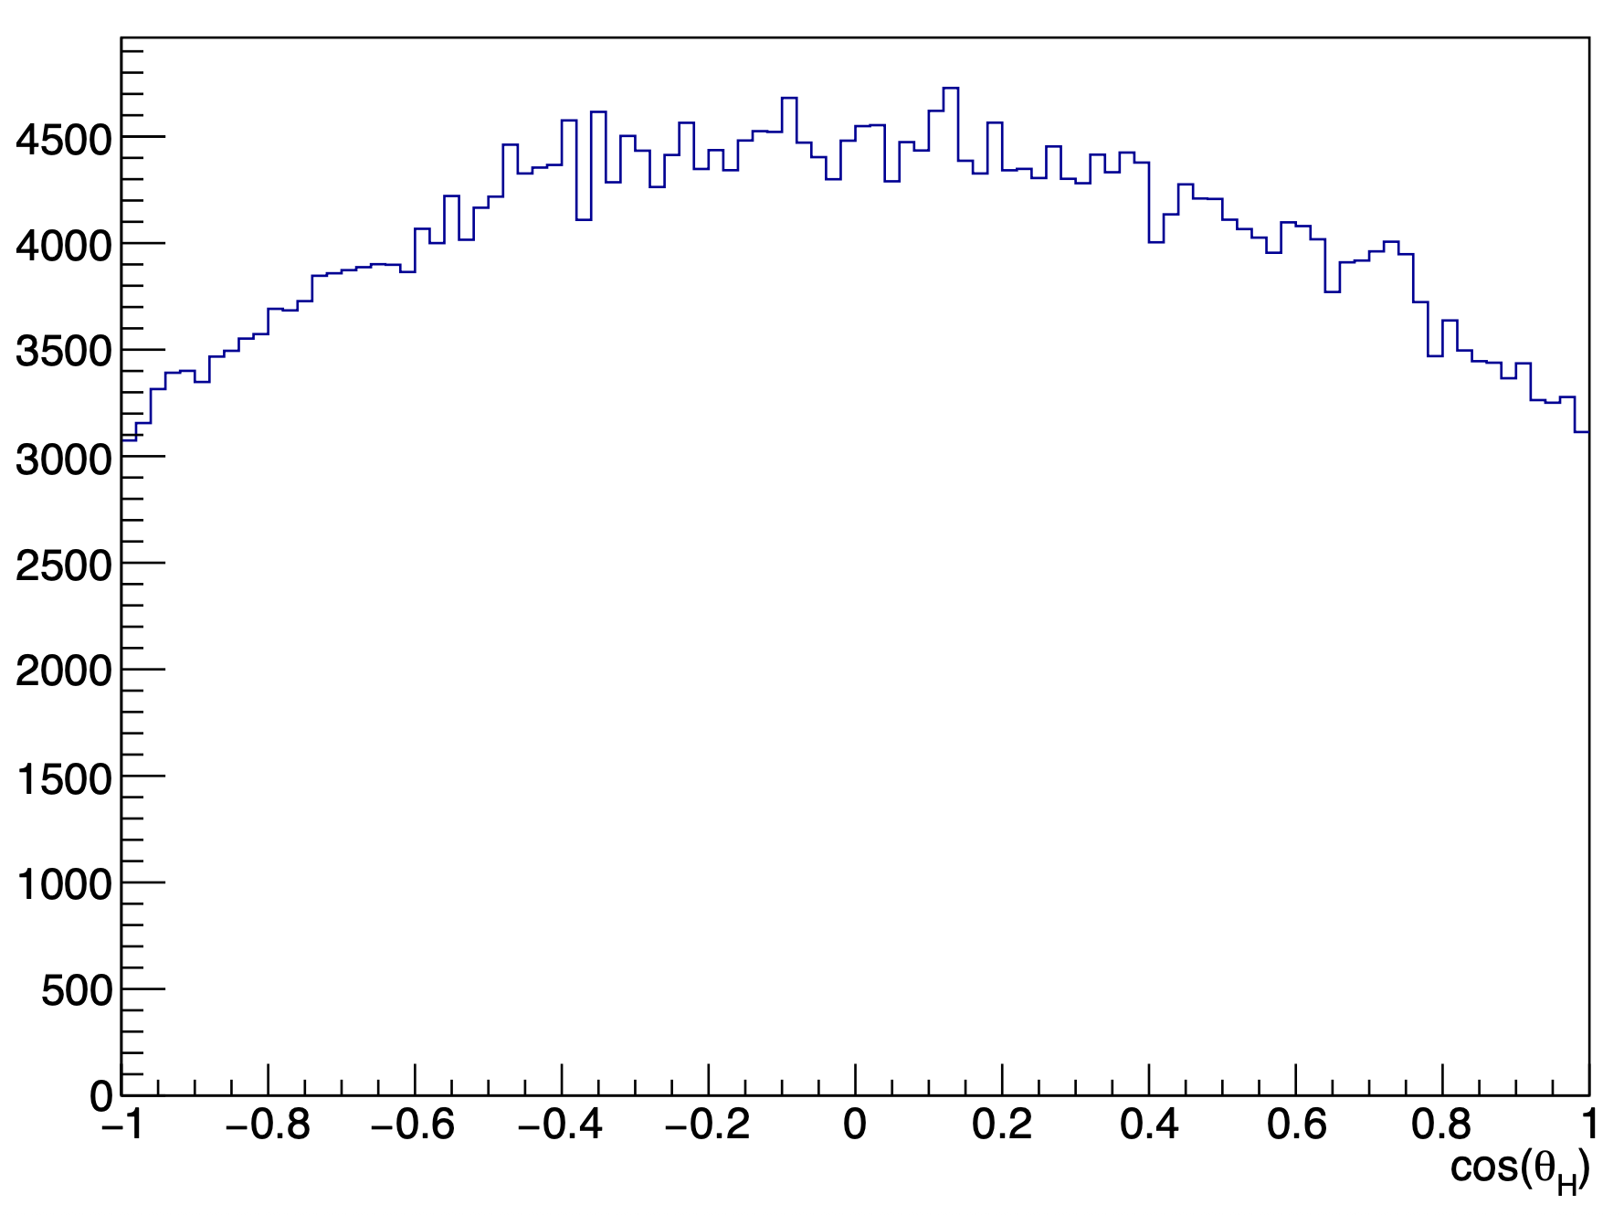
Include SDME in the simulation (generated plots)
With no cut on Q²
Mathieu Ronayette
4/11
Mathieu Ronayette
LSN Meeting
10 April 2026

Slide 24
Include SDME in the simulation (generated plots)
Mathieu Ronayette
4/11
Mathieu Ronayette
LSN Meeting
10 April 2026

Slide 25
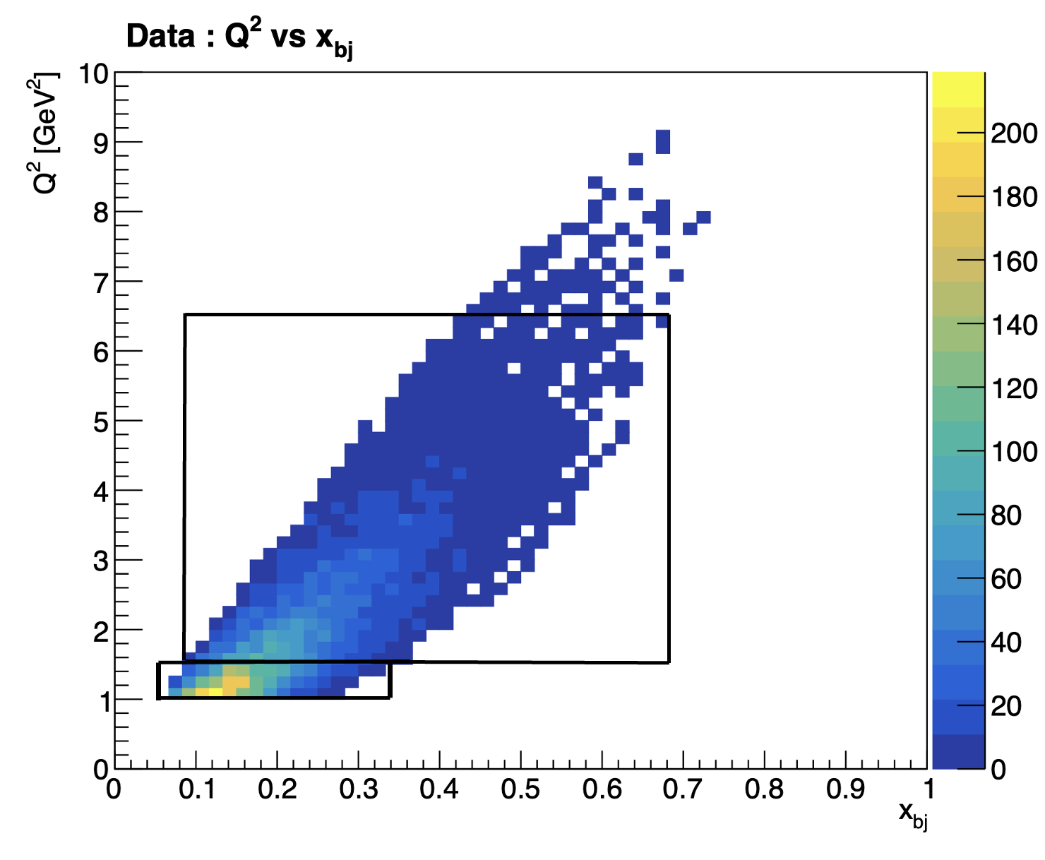
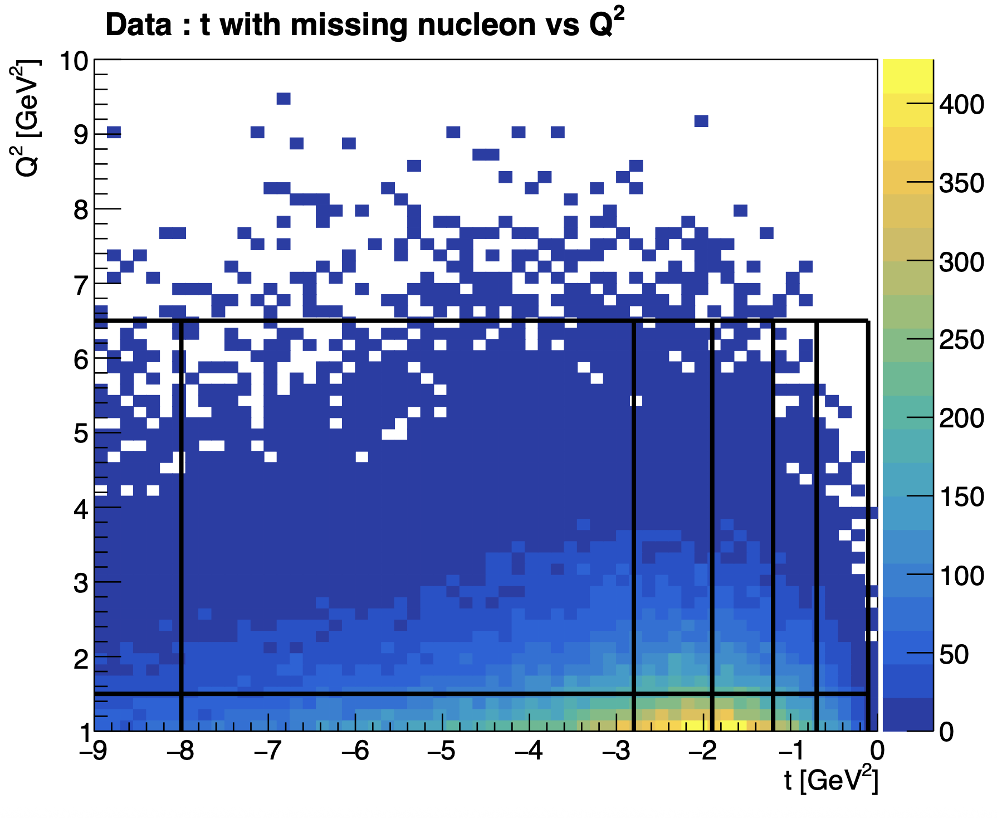
Binning of the data
• t binning for the two bins in Q²
Mathieu Ronayette
9/12
Mathieu Ronayette
LSN Meeting
10 April 2026

Slide 26


Cut on total missing mass
Total missing mass e n → e’ n’ K⁺ K⁻ X
(after all the previous cut)
Mathieu Ronayette
10/17
Mathieu Ronayette
Clas12 Collaboration Meeting
12 March 2026

Slide 27








Yield extraction per bins
Some examples of fits
Mathieu Ronayette
14/17
Mathieu Ronayette
Clas12 Collaboration Meeting
12 March 2026

Slide 28


Neutron efficiency correction additional plots
Mathieu Ronayette
20/20
Mathieu Ronayette
Clas12 Collaboration Meeting
11 March 2026

Slide 29




Efficiency correction for neutron in the FD
• Neutron efficiency in MC :
• Neutron efficiency (FD) in data from Lamya Baashen thesis
(with P_{mm} the missing momentum)
• The ratio between the MC and data efficiencies gives the neutron efficiency correction factor
• We are in the fiducial volume for reconstructed and genrated event
Mathieu Ronayette
6/17
Mathieu Ronayette
Clas12 Collaboration Meeting
12 March 2026

Slide 30


Cut on the angle between missing nucleon and detected neutron
Without the angle cut
With the angle cut
Mathieu Ronayette
9/20
Mathieu Ronayette
Clas12 Collaboration Meeting
12 March 2026

Slide 31

Cut on the status of K⁺K⁻
Generated event : p vs theta for K⁺⁻
Two justifications to cut K+ K- in CD :
Reconstruction of kaons in the CD is less good than in the FD
The generator predict few events in the CD
Mathieu Ronayette
12/20
Mathieu Ronayette
Clas12 Collaboration Meeting
12 March 2026

Slide 32


Neutron phasespace :
MC : θ_{neutron} vs P_{neutron} generated
(with acceptante cuts)
Mathieu Ronayette
20/20
Mathieu Ronayette
Clas12 Collaboration Meeting
11 March 2026

Slide 33


Neutron phasespace :
P. Chatagnon’s plot
Neutron detection efficiency in the FD
Neutron detection efficiency in the CND
Mathieu Ronayette
20/20
Mathieu Ronayette
Clas12 Collaboration Meeting
11 March 2026

Slide 34



ɸ generator for MC simulation
From Proposal to Jeﬀerson Lab PAC39 Exclusive Phi Meson Electroproduction with CLAS12
Mathieu Ronayette
20/20
Mathieu Ronayette
rgB - meeting
13 Feb 2026

Slide 35



Generator plots
Mathieu Ronayette
20/20
Mathieu Ronayette
Clas12 Collaboration Meeting
11 March 2026

Slide 36


Generator plots
Mathieu Ronayette
20/20
Mathieu Ronayette
Clas12 Collaboration Meeting
11 March 2026

Slide 37

Generator plots
Mathieu Ronayette
20/20
Mathieu Ronayette
Clas12 Collaboration Meeting
11 March 2026

Slide 38


Generator plots
Mathieu Ronayette
20/20
Mathieu Ronayette
Clas12 Collaboration Meeting
11 March 2026

Slide 39


Generator plots
With this cuts : 5.25 < P_{electron} < 8 GeV and P_{proton} > 0.45 GeV
my generator
Bhawani plot
Mathieu Ronayette
20/20
Mathieu Ronayette
Clas12 Collaboration Meeting
11 March 2026

Slide 40


Generator plots
With this cuts : 5.25 < P_{electron} < 8 GeV and P_{proton} > 0.45 GeV
my generator
Bhawani plot
Mathieu Ronayette
20/20
Mathieu Ronayette
Clas12 Collaboration Meeting
11 March 2026

Slide 41


Generator plots
With this cuts : 5.25 < P_{electron} < 8 GeV and P_{proton} > 0.45 GeV
K⁺
my generator
Bhawani plot
Mathieu Ronayette
20/20
Mathieu Ronayette
Clas12 Collaboration Meeting
11 March 2026

Slide 42


Generator plots
With this cuts : 5.25 < P_{electron} < 8 GeV and P_{proton} > 0.45 GeV
my generator
Bhawani plot
Mathieu Ronayette
20/20
Mathieu Ronayette
Clas12 Collaboration Meeting
11 March 2026

Slide 43


Generator plots
With this cuts : 5.25 < P_{electron} < 8 GeV and P_{proton} > 0.45 GeV
my generator
Bhawani plot
Mathieu Ronayette
20/20
Mathieu Ronayette
Clas12 Collaboration Meeting
11 March 2026

Slide 44


Generator plots
With this cuts : 5.25 < P_{electron} < 8 GeV and P_{proton} > 0.45 GeV
my generator
Bhawani plot
Mathieu Ronayette
20/20
Mathieu Ronayette
Clas12 Collaboration Meeting
11 March 2026

